Slide 1
Introduction to ABAP/4
Programming
Rajesh Mishra

Slide 2
Reporting and ABAP/4 Development Functions
The Reporting function is used to start reports.
The ABAP/4 development function is used to develop ABAP/4 programs. This function is also used to start reports.
ABAP/4:Program Execution
Reporting
Execute with variant
Execute
. . . .
Program
ABAP/4:Program Development: Initial Screen
ABAP/4
development
Program Status Create
Execute
Options
Source code
Variants
Attributes
Documentation
Text elements
Display Change

Slide 3
ABAP/4 Programming Environment
The functions shown here are the most important functions required at the beginning of the course. Further functions are available under the Utilities submenu
ABAP/4 editor with
syntax check
HELP <statement>
Program lines
Online documentation
ABAP/4
development
ABAP/4 debugging mode
SHOW <table>
Program lines
Display data
Dictionary Tables
Display / Change
Field contents

Slide 4
Copying ABAP/4 Programs
1 Complete program including environment
2 Program sections
ABAP/4
Step 1: ABAP/4 Editor with source program
Development
ABAP/4: Editor source program
000010 aaaaa
XX0020 bbbbb Select line interval
000030 ccccc and place in
XX0040 ddddd buffer
000050 eeeee
Copy
Step 2: Editor command line
FETCH target program
Step 3: ABAP/4 Editor with target program
ABAP/4: Editor target program
000010 mmmmm
X00020 nnnnn Copy buffer
000030 ppppp

Slide 5
ABAP/4 Syntax
An ABAP/4 program consists of a series of individual statements.
Each statement must end with a period.
The first word in a statement is the key word.
Words are separated by at least one blank.
Statements can be indented.
Statements can extend over several lines.
DATA COUNTER TYPE I.
DATA NAME(20).
MOVE 1 TO COUNTER.
MOVE 'ABC' TO NAME.
.
.
.
WRITE NAME.
WRITE COUNTER.
ABAP/4 program
Statement.
Word 1
Word 2
Word 3
Word 4
.
Key word
Parameter, field, constant

Slide 6
Chain Statements
Successive statements starting in the same way can be joined together to form a chain statement.
Enter the command once only, followed by a colon.
After the colon, separate each chain statement component by a comma.
You can insert blanks before and after the separators (which may be colons, commas, or periods).
WRITE 'XYZ'.
WRITE NAME.
WRITE COUNTER.
WRITE: 'XYZ', NAME,
COUNTER.
ADD 1 TO COUNTER1.
ADD 1 TO COUNTER2.
ADD 1 TO COUNTER3.
ADD 1 TO: COUNTER1,
COUNTER2,
COUNTER3.

Slide 7
Comments
You can enter comments in your programs in two ways:
  By entering an asterisk (*) in column 1, you mark the complete line as a comment.
  By entering a quotation mark (") within a line, you can mark the remainder of the line as a comment.
DATA: SUM TYPE P, " Totals field
COUNTER TYPE P.
* New account
* Initialize totals field
CLEAR SUM.

Slide 8
Program Structure
Every ABAP/4 program must start with either the PROGRAM or REPORT statement.
  Recommendation:
    Use the REPORT statement for ABAP/4 reports and the PROGRAM statement for general ABAP/4 programs, for example, module pools.
All global data declarations must be collected together at the beginning of the program in a declaration section.
REPORT name ... .
or
PROGRAM name ... .
*Declaration section
DATA: ... .
TABLES: ... .
*Statement section

Slide 9
Attributes
The SAP transport system requires you to assign an ABAP/4 program to a development class and, if applicable, to identify it as a local, private object. The attributes "type", "application" and "class" are used for the management of ABAP/4 programs.
Within the Reporting and ABAP/4 development functions, you can display a list of all ABAP/4 programs stored in the system. To do this, you use the Program directory function. The Reporting function lists only type 1 programs (reports). You can generate a selective list: with a generic report name,eg, RFSCHU* - for an application system, eg, RF financial accounting
ABAP/4
ABAP/4 program attributes
Development
Type.............. 1 Reporting
Status........... T Test
Application.. S System
Class............ SCH Training
. . . . . . . . . . . .
. . . . . . . . . . . .
Attributes
F4
F4
Typ 1: Report
M: Module pool,
Online program
V: Update program
Status T: Test
P: Productive use
K: Customer program
S: System program

Slide 10
Attributes II
ABAP/4 program attributes
You must maintain the type and application attributes. All other attributes are optional, or else are only needed for specific read accesses or when you have additional requirements.
Press the F1 or F4 help key for information about the significance of the attributes and possible input values.
Typ................. 1 Reporting
Status............ T Test
Application... S System
Class............. SCH Training
. . . . . . . . . . . .
. . . . . . . . . . . .
F4
F4
Class Application Text
DEBI F Customers
KRED F Vendors
SCHU S Training
Application Report class
G: General Ledger Table RCL
F: Financial accounting
.
.
.

Slide 11
Starting an ABAP/4 Report
You use the editor Execute function to start an ABAP/4 program directly from the editor.
In online programming, an ABAP/4 program (module pool) is activated by the transaction assigned to it. You link the transaction code to the ABAP/4 module pool by making an entry in Table TSTC.
1
2
Start reports via menu
Start report from the ABAP/4 Editor
ABAP/4 Programm Attribute
ABAP/4
ABAP/4 Editor RSDEMO00
Development
Execute
Reporting
PROGRAM RSDEMO00.
.
.
.
WRITE
RSDEMO00
Execute
Execute

Slide 12
Simple Output Statements

Slide 13
WRITE Statement
REPORT B170D031.
WRITE: '**********************'.
SKIP 2.
WRITE: 'Date', SY-DATUM.
WRITE: 'Time', SY-UZEIT.
SKIP 2.
WRITE: '**********************'.
WRITE outputs the contents of a field or constant in a format appropriate to the data type.
Successive WRITE statements output data on the same output line. When an output line is full, output continues on the next line.
SKIP generates blank lines.
ABAP/4 normally generates two header lines for each page. The date and the page number are displayed on the first header line with a list title, if maintained.
ABAP/4 Programm Attribute
01.01.1995 1
***************************************
Date 01.01.1995 Time 14:46:10
***************************************

Slide 14
Format Specifications
You can specify a format for the output value. This allows you to start a new line, as well as determine a start column and output length.
ULINE generates a line.
REPORT B170D032.
WRITE: 5'***********************'.
SKIP.
WRITE: 5 'Date', 20 SY-DATUM,
/5 'Time', 20 SY-UZEIT.
ULINE /5(30).
SKIP2.
ULINE.
ABAP/4 Programm Attribute
01.01.1995 1
********************************************
Date 01.01.1995
Time 16:18:38
********************************************
---------------------------------------------------------------------
Column 5
Column 20

Slide 15
Format Options
The formatting option DD/MM/YYYY formats a date field in accordance with the information in the user master record (select System → User profile → User defaults).
The formatting option UNDER allows you to display a value (left justified) immediately beneath a value which has already been output. (The line feed must be explicitly programmed.)
REPORT B170D033.
.
.
.
WRITE: 5 'Date',
20 SY-DATUM.
WRITE: /5 'Time',
SY-UZEIT UNDER SY-DATUM.
ABAP/4 Programm Attribute
1
Date 01.01.1995
Time 07:08:17
Column 5
Column 20

Slide 16
Syntax of the WRITE Statement
The format specification must precede the output value.
The complete format or individual format specifications can be omitted.
The sequence for the format specification must always be as above.
Individual output values within a line are separated by a blank.
The formatting options must always appear after the output value.
WRITE <format> <value> <options>.
<format>
/p(l)
/ Line feed
p Column position
l Output length
<value>
<options>
Output value
field or literal
Format options

Slide 17
NEW-PAGE
NEW-PAGE starts a new page and causes the list to be formatted in pages.
You scroll in the list using the scroll keys or the scroll bar (see the preface).
On the screen a list is normally displayed which is not divided into pages.
The NEW-PAGE statement will not create an empty page
REPORT B170D035.
WRITE: /'Date', SY-DATUM,
/'Time', SY-UZEIT. . . .
NEW - PAGE.
WRITE: /'User', SY-UNAME UNDER SY-DATUM,
/'System', SY-SYSID UNDER SY-DATUM.
ABAP/4 Programm Attribute
1
Date 01.01.1995
Time 07:08:17
2
User Everyman
System S50

Slide 18
Page Header I
You can maintain a list heading and up to four column headings for the report list by selecting the MAINTAIN HEADINGS function.
The header lines are then displayed automatically in the list the next time the report is started.
Save
Maintain headings
ABAP/4 Programm Attribute
Display
Name
system fields
Value
-
-
-
....+....1....+....2....+...

Slide 19
Page Header II: Text Elements
ABAP/4
Development
ABAP/4 Programm Attribute
Title and headings
Language D
Title
Page layout
List heading
Display system fields
Column headings
Name Value
-
-
-
Text elements
Title and headings
You can maintain title and column headings either with the TEXT ELEMENTS function or directly from the list display (function MAINTAIN HEADINGS).
The list heading appears as the first header line in the list. If no list title is maintained, the report title is used instead.
You can maintain the texts in the various system languages (TRANSLATION menu).
Save

Slide 20
Numbered Texts
REPORT B170D037.
WRITE: TEXT-001, 10 SY-Datum . . . .
'Time'(002), 10 SY-UZEIT . . . .
Text elements
No Text Language
D
001 Date
002 Time
Numbered texts
You maintain numbered texts using the TEXT ELEMENTS functions.
You can maintain numbered texts separately for different languages.
There are two methods of activating numbered texts:
  - TEXT-xxx (xxx is a three-digit number)
  - 'string'(xxx).
The second alternative has the advantage that the text contents are also included in the program code.
If you have chosen the second alternative, you can use subfunction COMPARE TEXT POOL to ensure that:
  1. the text in the program is identical to the text in the text pool.
  2. strings from the program text are transferred to the text pool.
  Note:
  During processing, the string stored in the text pool under the relevant number is used in case of doubt (language-specific).
Data 01.01.1995
Time 13:25:07

Slide 21
ABAP/4 Data

Slide 22
Data Types Their Attributes
In packed fields two figures are stored in a single byte. The sign is stored in the final half-byte.
Type I is defined as a binary number with a guaranteed set of values from -21477483648 to +2147483647.
Recommendation for use of numerical data types:
  I: integers (for example, counters)
  P: commercial calculations (decimal numbers or large value range)
  F: mathematical calculations (large number range, considerable accuracy)
The complete data area of an ABAP/4 program should not exceed approx. 64,000 bytes.
Data type Meaning Initial value Standard Allowed
length length
Packed number 0 8 1-16
Integer 0 * -
Floating point no. 0.000... * -
Numeric text 00...0 1 1-max.
Text Blank 1 1-max.
Date YYYYMMDD 00000000 8 8
Time HHMMSS 000000 6 6
Hexadecimal X'00' 1 1-max.
*: Machine-specific max.: approx. 64,000 Byte
Default type is Character.

Slide 23
Constants
ABAP/4 recognizes two types of constants:
  Number literals for data types P and I and text literals for data types C and N. Since there are no type-specific constants for the remaining data types, use a text literal.
  Note:
  If you want to assign a value with decimal places to a field of type P, you must define it as a text literal (for example, "2.17").
ABAP/4 generates a value appropriate to each type internally (see transparency on type conversion).
If a text literal contains an inverted comma, the inverted comma must be entered twice.
Text literal
'ABC', 'This is a text'
Sequence of characters enclosed
in quotes, max. of 255 characters
Type Constant
579, -713, '2.17'
917, -882
'25.873', '1.213E15', '17E-6', '0.556E7'
778, '87931'
'AXZ', 'B123', 'AB"CD'
'19920221'
'105743'
'0FFF'
Number literal
715, -431
Sequence of digits, negative numbers
with preceding minus sign

Slide 24
Data Declaration
Naming recommendations:
    Always enter a letter as the first character. The remaining characters can be either letters or figures.
    Do not use special characters apart from the underscore (for compound names).
If the type specification is missing, the field is of type C.
If the length specification is missing, the standard length for the type applies.
You can specify an initial value with the parameter VALUE. After the parameter VALUE, you can only specify a constant.
DATA: COUNTER TYPE I ,
NAME1(25) VALUE 'SAP',
START_DATE TYPE D,
FIRST_LINE TYPE I
VALUE 1,
SUM1(5) TYPE P.
Rules for assignment of field names
A name consists of a max. of 30 characters
(letters, digits, special characters)
The following special characters should not
be used:( ) + . , :
SPACE is a predefined field.
In an ABAP/4 statement, the name
of a parameter cannot also be used
as a field name.

Slide 25
Declaring Fields of the Same Type
Use the LIKE parameter to declare fields which require the same attributes as a field which has already been defined.
The reference field can be either an internal or a database field.
If you use the LIKE parameter, you can write programs which are easy to change, since, if the data attributes change, you need make this change at only one point in the program.
The CLEAR statement sets a field to the initial value appropriate to its type. CLEAR does not save an initial value specified with VALUE.
DATA: NAME1(25) TYPE C,
NAME2 LIKE NAME1,
NAME3 LIKE NAME1.
CLEAR <field>.
Sets a field to the initial value
appropriate for its type

Slide 26
Type-specific Output
If no length is specified in the output format for an output field, the standard output length applies.
If the length specified in the output format exceeds that required, the value is output either left or right justified according to type by the appropriate amount for the output length.
When fields of types P/I are o/p, leading zeros converted to blanks and commas inserted between thousands.
If the output length you select is too small for the numerical values (data types P, I, F), the value is output in truncated form preceded by an asterisk.
Type Standard output length Output
2* Ig right-justified
( * ) right-justified
22 right-justified
Ig left-justified
Ig left-justified
8 left-justified
6 left-justified
2 *Ig left-justified
lg = Length of the field (in bytes) (*) according to the largest representable number

Slide 27
Outputting Floating-Point Numbers
Use the EXPONENT parameter of the WRITE statement to determine the value of the exponent when outputting floating point numbers. The decimal point is positioned correctly.
With the DECIMALS parameter, you can determine the number of decimal places after the decimal point when outputting fields of type P, I, or F. The last place is rounded.
REPORT B170D044.
DATA: F1 TYPE F
VALUE '12.345678E2'.
WRITE: / F1 ,
/ F1 EXPONENT 1 DECIMALS 4,
/ F1 EXPONENT 0 DECIMALS 2.
+ 1,234567800000000E+03
+123,4568E+01
+1234,57

Slide 28
Value Assignment
There are a number of ABAP/4 statements which assign a value to a field. The two most important are the MOVE and COMPUTE statements. The key word COMPUTE is optional.
If the type and length of the field does not match the assigned value, the system carries out automatic type conversion.
In addition, the ADD, SUBSTRACT, MULTIPLY and DIVIDE statements are provided for simple arithmetic operations.
PROGRAM B170D045.
DATA: NAME1(25),
SORT_NAME(10),
FIRST_LINE(4) TYPE N,
NEXT_LINE TYPE I.
.
.
.
MOVE 'SAP' TO NAME1.
MOVE 5 TO FIRST_LINE.
COMPUTE NEXT_LINE = FIRST_LINE + 1.
SORT_NAME = NAME1.
ADD 1 TO NEXT_LINE.

Slide 29
Type Conversion (Example)
Fields of type C are stored left-justified and can be filled with blanks from the right or truncated.
If a field of type C is assigned to a field of type P, only figures, the plus/minus sign, and the decimal point are allowed.
If a packed field is assigned to a field of type C, the numerical value is formatted (commas to separate thousands, decimal comma, sign) and the leading zeros are converted to blanks.
If you do not want this type of formatting, use the UNPACK statement.
  Depending on whether the packed field is defined with decimal places, the appropriate number of figures after an existing decimal point are transferred from the C field:
  for example: C field P field (DECIMALS 2)
  -47.110 47.11-
Source field
Target field
Type Length Value
Type Length Value
1 A 8 A____
4 ABCD 2 AB
7 -47110 4 47110-
3 12345- 7 12.345-

Slide 30
Arithmetical Expressions
The key word COMPUTE is optional.
There is no limit to the number of nesting levels for parenthesized expressions.
Operators and parentheses are considered as words.
    Incorrect: a = (B+EXP(C))*E/SIN(3-G).
    Correct: a = ( B + EXP( C ) ) * E / SIN( 3 - G ).
Non-numerical values are converted to numerical values prior to the arithmetical operation.
The operators DIV and MOD are whole number division functions.
The STRLEN function returns the length of a string.
PROGRAM B17D046.
DATA: COUNTER TYPE I,
AMOUNT TYPE P VALUE 1000,
SUM TYPE P,
RESULT TYPE P,
NUMBER(2) TYPE C VALUE '99',
ROOT TYPE F.
COMPUTE: COUNTER = COUNTER + 2,
RESULT = AMOUNT * COUNTER.
SUM = RESULT + NUMBER - COUNTER.
RESULT = COUNTER * (AMOUNT + NUMBER).
ROOT = SQRT(NUMBER + COUNTER).
Operators
+ - / *
Functions
SQRT EXP LOG
SIN COS STRLEN
DIV
MOD

Slide 31
System Fields
ABAP/4 provides a series of system fields.
You reference the system fields in the program with SY-<field name>.
Editor command
SHOW SY
SHOW SY
Name Type Length Meaning
SYST-DATUM DATE 8 Date
SYST-UZEIT TIME 6 Time
SYST-UNAME CHAR 12 User name
SYST-SUBRC HEX 2 Return code
SYST-REPID CHAR 8 Program name
SYST-LANGU CHAR 1 Logon language
.
.
.

Slide 32
Sub-Fields
By specifying offset and length, you can activate and change parts of fields.
Only a few statements (ASSIGN, actual parameters, WRITE ... TO) support variable offset and length specifications.
PROGRAM B170D48.
DATA: ACCOUNT(10) TYPE C,
START LIKE SY-DATUM.
ACCOUNT = '1234567890'.
START = '19950715'.
WRITE: ACCOUNT+8(2), '**',
START(4).
* Start of month
START+6(2) = '01'.
ACCOUNT+6 = '9999'.
WRITE: / ACCOUNT, '****',
START.
90 ** 1995
1234569999 **** 01.07.1995

Slide 33
Date Calculations
If a date field is assigned to a packed field, ABAP/4 calculates the number of days since the beginning of 1900.
Conversely, if a packed field is assigned to a date field, it is interpreted as the number of days since the beginning of 1900.
Before an arithmetic operation is performed, the values of the date fields are converted to packed values (number of days since the beginning of 1900).
PROGRAM B170D047,
DATA: DIFF TYPE P.
DATE_1 LIKE SY-DATUM,
DATE_2 LIKE SY-DATUM.
DATE_1 = SY-DATUM.
DATE_2 = SY-DATUM.
* Start of month
DATE_2+6(2) = '01'.
* Last day of previous month
DATE_2 = DATE_2 - 1.
* Difference in days
DIFF = DATE_1 - DATE_2.

Slide 34
Declaring Fields with PARAMETERS
PARAMETERS <field>.
The PARAMETERS statement is used to declare internal fields. In contrast to fields declared with the DATA statement, you can specify values for these fields on the selection screen when you call the report.
Some of the parameters of the DATA statement can also be used with the PARAMETERS statement (for example, TYPE, LIKE, DECIMALS, etc.). While DATA allows you to assign initial values to fields with VALUE, PARAMETERS allows you to set a default value with DEFAULT.
REPORT B170D049.
PARAMETERS: PAR1 TYPE P,
PAR2 DEFAULT 'X'.
.
.
.
MOVE PAR1 TO ... .
WRITE: PAR1, PAR2.
.
.
.
Selection
screen
.
.
.
PAR1 -
PAR2 X

Slide 35
Retrieving Data with the SELECT Statement

Slide 36
SELECT Statement I
You can use the SELECT statement to read the table entries (records) in a table
You use the TABLES statement, to declare the structure of a table to the program.
Reference the fields of a table by specifying the table name followed by the field name.
Table work area TABNA
Table
TABNA
COUNTRY ID NAME1
PROGRAM B170D061.
TABLES: TABNA.
SELECT * FROM TABNA.
WRITE: / TABNA-COUNTRY, TABNA-ID,
TABNA-NAME1, ... .
ENDSELECT.
Table description TABNA
SHOW TABNA
DDIC
TABNA-COUNTRY CHAR C 3
TABNA-ID CHAR C 8
TABNA-NAME1 CHAR C 25
Name Type Length

Slide 37
SELECT Statement II
The WHERE parameter allows you to restrict the quantity of table entries to be read. In the example shown here, only table entries where the table field TABNA-COUNTRY has the value USA are read.
The field specified in the WHERE clause to the left of the relational operator must be a table field from the table to be read. It must be referenced here without the table name.
The return code field SY-SUBRC is set to a value not equal to zero if no table entry is found for the current WHERE condition.
REPORT B170D062.
TABLES: TABNA.
SELECT * FROM TABNA
WHERE COUNTRY = 'USA'.
ENDSELECT.
IF SY-SUBRC NE 0.
ENDIF.
statements
statements

Slide 38
Control Statements

Slide 39
Overview of Control Statements
ABAP/4 does not have a GOTO statement.
Other statements include the LOOP ... ENDLOOP statement for reading an internal table and the AT ... ENDAT case distinction statement for control level processing within the LOOP statement.
Case distinction
IF ENDIF
ON CHANGE OF ENDON
CASE ENDCASE
Loops
DO ENDDO
WHILE ENDWHILE
Other control statements
CHECK
EXIT
STOP

Slide 40
Relational Operators
If the operands to be compared are not of the same data type, type conversion is carried out. If, when you compare two fields of type C, one field is shorter than the other, the length of the shorter field is matched to that of the longer field and is filled with blanks from the right.
Display
Meaning
EQ = Equal to
NE <> >< Not equal to
GT > Greater than
GE >= => Greater than or equal to
LT < Smaller than
LE <= =< Smaller than or equal to
DATA: START TYPE D,
SUM1 TYPE F,
SUM2 TYPE P.
.
.
.
IF START IS INITIAL ... .
IF SUM1 GT SUM2 ... .
IF SUM1 BETWEEN 0 AND 100 ... .
BETWEEN f1 and f2 Interval
IS INITIAL Initial value

Slide 41
String Comparison Operators
After each character string comparison, the system field SY-FDPOS is set.
    for example 'ABCDE' CS 'DE' →
    SY-FDPOS = 3
    SY-FDPOS contains the offset of the first character from 'DE' into 'ABCDE'.
<f1> CO <f2> contains only: f1 contains only characters from f2
ACCOUNT CO '0123456789'
<f1> CA <f2> contains any: f1 contains at least one character
from f2
<f1> CS <f2> contains string: f1 contains the string f2
'ABCDE' CS 'DE'
<f1> CP <f2> contains pattern: f1 corresponds to the model f2
Model:
* any string
+ any character
'ABXDE' CP '*B+D*'

Slide 42
Logical Expressions
A logical expression consists of comparisons, the logical operators NOT, AND, and OR as well as parentheses.
Operators and parentheses are considered as words. Consequently, they must be separated from one another by blanks.
When processing a logical expression, the order of priority for the logical operators is: NOT AND OR.
COUNTER GE 0
COUNTER GT 0 AND
FLAG IS INITIAL
(FLAG1 NE SPACE OR FLAG2
NE SPACE) AND COUNTER
BETWEEN 0 AND 100
COUNTER EQ 0 AND NOT
(FLAG1 EQ SPACE AND FLAG2
EQ SPACE)

Slide 43
IF Statement
The ELSE and ELSEIF statements are optional.
If the conditions of the logical expression are met, the subsequent statement sequence is executed.
If the conditions of the logical expression are not met, the ELSE or ELSEIF statement is processed. If there is no ELSE or no further ELSEIF statement, processing of the program continues after ENDIF.
You can insert any number of ELSEIF statements between IF and ENDIF. Only one of the statement sequences will be executed.
Control statements can be nested.
IF <logical expression>.
ENDIF.
IF <logical expression>.
ELSE.
ENDIF.
IF <logical expression>.
ELSEIF <logical expression>.
ELSEIF <logical expression>.
ELSE.
ENDIF
statements
statements
statements
statements
statements
statements
statements

Slide 44
CASE Statement I
Only one of the statement sequences shown is processed.
The WHEN OTHERS statement is optional.
You can specify only one value after WHEN. Either specify the value as a literal or name the field which contains the value.
CASE <field>.
WHEN <value1>.
WHEN <value2>.
WHEN <value3>.
WHEN OTHERS.
ENDCASE.
statements
statements
statements
statements

Slide 45
ON CHANGE OF Statement
The statements between ON CHANGE OF and ENDON are only processed if the contents of the field specified after ON CHANGE OF have changed. ABAP/4 always makes a note of the previous value in an internal field.
The additional parameter OR allows you to refer to several fields:
  ON CHANGE OF <field1> OR <field2> OR <field3>.
  <statements>
  ENDON.
If the contents of at least one field have changed, the subsequent statements are processed.
PROGRAM B170D071.
TABLES: TABNA.
SELECT * FROM TABNA.
ON CHANGE OF TABNA-COUNTRY.
NEW-PAGE.
ENDON.
WRITE: / TABNA-COUNTRY,
TABNA-NAME1, ... .
ON CHANGE OF <field>.
Table TABNA
COUNTRY
NAME1
A Demel
A Zander
D Albers

Slide 46
DO Loop
You can specify the value for the number of loop passes in the form of a constant or field.
Parameter <n> TIMES is optional. If you do not specify this parameter, you must include a termination condition within the loop statement (see EXIT statement).
]
DO <n> TIMES.
ENDDO.
statements
SY-INDEX
Loop index

Slide 47
WHILE Loop
The statement sequence will continue to be executed for as long as the conditions of the logical expression are fulfilled.
WHILE <logical expression>.
ENDWHILE.
statements
SY-INDEX
Loop index
WHILE COUNTER > 0.
.
.
.
SUBTRACT 1 FROM COUNTER.
ENDWHILE.

Slide 48
CHECK Loop
If CHECK is specified in a loop structure and the conditions of the logical expression are not fulfilled, the subsequent statements in the current loop pass are not executed, and processing resumes with the next loop pass.
If a CHECK condition within a subroutine is not satisfied, the subroutine terminates.
If a CHECK statement is outside a loop structure and the conditions of the logical expression are not satisfied, subsequent statements in the current processing block are not executed.
CHECK <logical expression>.
1
CHECK within a loop structure.
WHILE COUNTER GT 0
CHECK FLAG NE SPACE.
ENDWHILE.
statements
statements
2
CHECK outside loop structures.
statements
CHECK <condition>.
statements

Slide 49
EXIT Statement
The EXIT statement within a loop structure terminates the current loop.
The EXIT statement within a subroutine terminates the current subroutine.
If you specify the EXIT statement outside a loop or subroutine, report processing is terminated and the list is displayed after execution of the EXIT statement.
EXIT.
1
EXIT within a loop structure.
DO
IF COUNTER GE 100.
EXIT.
ENDIF.
ENDDO.
statement
statement
2
EXIT outside loop structure.
statement
IF ... .
EXIT.
ENDIF.
statement

Slide 50
Data Structures

Slide 51
ABAP/4 Data Structures
Fields which logically belong together are combined in a field string. You can reference all fields in a field string by specifying the name of the field string (the field string is considered here as a character structure). To reference a single field, specify the name of the field string followed by the field name (for example, ADDRESS-NAME).
Field strings are used, for example, in connection with subroutines and sequential datasets.
A table work area defined in an ABAP/4 program with the TABLES statement is comparable in structure to a field string.
An internal table consists of a header line and a number of identically structured table lines. The header line corresponds in structure to a field string.
The header line is the work area of an internal table. When an internal table is filled, the data is first placed in the header line. By means of appropriate statements, the contents of the header line are then transferred to the table itself. When an internal table is read, ABAP/4 places the contents of the individual table lines in the header line.
Field string
ADDRESS
Name First Name City Street
Internal tables
ADDRESS_LIST
Name First Name City Street
Header line

Slide 52
Declaring a Field String
You declare a field string with the DATA statement. The start and end of the field string are indicated by BEGIN OF <name> and END OF <name>.
You define the sub-fields of a field string in the same way as individual fields, specifying length, type, and, if appropriate, an initial value. With the LIKE parameter, you can adopt the attributes of internal fields which have already been declared, or the attributes of fields defined in the Data Dictionary.
Reference fields in a field string as follows:
<field string>-<field name>.
You can reference a complete field string (for example, WRITE: <field string>.). Please note that the complete field string is then considered as a field of type C. Type conversion does not take place. In the example shown here, a field string contains packed fields. The WRITE ADDRESS statement would, therefore, not produce meaningful output.
DATA: BEGIN OF <name>, ... ,
END OF <name>.
REPORT B170D081.
DATA: AMOUNT(5) TYPE P,
BEGIN OF ADDRESS,
FLAG TYPE C,
ID LIKE TABNA-ID,
NAME LIKE TABNA-NAME1,
CITY LIKE TABNA-CITY
AMOUNT1 LIKE AMOUNT,
END OF ADDRESS.
.
.
.
MOVE 'X' TO ADDRESS-FLAG.
ADD AMOUNT TO ADDRESS-AMOUNT1.
.
.
.
WRITE: ADDRESS-FLAG, ADDRESS-ID,
ADDRESS-AMOUNT1.

Slide 53
Field by Field Transport
The statement MOVE-CORRESPONDING <f1> to <f2> transports values field by field between the ABAP/4 data structures f1 and f2.
The system searches in f1 for all single fields that also occur in f2 and generates a statement for all pairs of fields found:
MOVE <f1>-<field name> TO <f2>-<field name>. The other fields remain unchanged.
If the data structures f1 and f2 are the same and the sequence and attributes of all sub-fields are identical, you can also use the statement MOVE <f1> TO <f2>. Under these conditions, this statement requires less runtime.
The CLEAR <f> statement resets all sub-fields of f to their initial value. The initial value varies according to field type.
MOVE-CORRESPONDING <f1> TO <f2>.
REPORT B170D082.
TABLES: TABNA
DATA: BEGIN OF ADDRESS,
FLAG TYPE C,
ID LIKE TABNA-ID,
NAME LIKE TABNA-NAME1,
CITY LIKE TABNA-CITY,
. . . ,
END OF ADDRESS.
TABNA
ID NAME1 CITY
00000001 WILLY WALLDORF
MOVE-CORRESPONDING TABNA TO ADDRESS.
ADDRESS
FLAG ID NAME CITY
00000001 WALLDORF
CLEAR <f1>.

Slide 54
Declaring an Internal Table
You declare an internal table in the same way as a field string. Here, the BEGIN parameter is extended to include the OCCURS parameter, which specifies the number of table entries in main storage (roll area).
  If more table entries are required than specified with the OCCURS parameter, these are rolled out to a main storage buffer or to the roll file.
You must enter a constant value after OCCURS.
DATA: BEGIN OF <tab> OCCURS <n>, ...,
END OF <tab>.
REPORT RSDEMO00.
TABLES: TABNA.
DATA: AMOUNT(5) TYPE P,
BEGIN OF ADDRESS_LIST
OCCURS 5,
FLAG TYPE C,
ID LIKE TABNA-ID,
.
.
AMOUNT 1 LIKE AMOUNT,
.... ,
END OF ADDRESS_LIST.
ADDRESS_LIST
FLAG ID NAME CITY AMOUNT1
Header line

Slide 55
Transferring R/3 Repository Table Structures
The INCLUDE STRUCTURE statement allows you to base the structure of internal tables or field strings on an R/3 Repository table. Objects such a field names, attributes and even conversion routines are all transferred in this way. The same applies when using LIKE with single fields.
REPORT B170D080.
.
.
.
DATA: BEGIN OF TAB OCCURS 5.
INCLUDE STRUCTURE TABNA.
DATA: END OF TAB,
NAME2 LIKE TABNA-NAME1.
TAB-CITY = . . .
INCLUDES STRUCTURE <tab>.
SHOW TABNA
TABNA - COUNTRY CHAR C 3
TABNA - ID CHAR C 8
TABNA - CITY CHAR C 25
TABNA - NAME1 CHAR C 30

Slide 56
Filling a Table I
The APPEND statement appends the contents of the header line at the end of the internal table.
The APPEND <tab> SORTED BY <f> statement adds a new entry to an internal table and sorts the table by field f in descending order.
APPEND <tab>.
APPEND <tab> SORTED BY <field>.
Country Sales
Country Sales
D 400 000 Header line
D 400 000 Header line
USA 1 000 000 1
D 7 800 000 1
GB 500 000 2
USA 1 000 000 2
D 7 800 000 3
GB 500 000 3
GB 50 000 4
A 140 000 4
A 140 000 5
6
7
8
9
GB 50 000 5

Slide 57
Filling an Internal Table II
In the first example, the table entries are saved in the sequence in which they are read. More than five entries can be saved.
In the second example, the table entries are sorted by the field SALES in descending order. A maximum of five table entries is saved.
REPORT B170D083.
TABLES: TABNA.
DATA: BEGIN OF TAB OCCURS 5,
COUNTRY LIKE TABNA-COUNTRY,
ID LIKE TABNA-ID,
SALES LIKE TABNA-SALES,
END OF TAB.
SELECT * FROM TABNA.
MOVE-CORRESPONDING TABNA TO TAB.
APPEND TAB.
ENDSELECT.
.
.
.
REPORT B170D084.
.
.
.
SELECT * FROM TABNA.
MOVE-CORRESPONDING TABNA TO TAB.
APPEND TAB SORTED BY SALES.
ENDSELECT.
.
.

Slide 58
Compressing Data with an Internal Table
COLLECT <tab>.
Country Sales (TYP P)
REPORT B170D085.
TABLES: TABNA.
DATA: BEGIN OF TAB OCCURS 10,
COUNTRY LIKE TABNA-COUNTRY,
SALES LIKE TABNA-SALES,
END OF TAB.
SELECT * FROM TABNA.
MOVE-CORRESPONDING TABNA TO TAB.
COLLECT TAB.
ENDSELECT.
D 400 000 Header line
USA 1 000 000 1
GB 550 000 2
D 7 800 000 3 8 200 000
4
5
6
7
8
9
The COLLECT statement includes the header line of an internal table in the table as a new entry or adds it to an existing entry of the same type.
ABAP/4 scans the table for an entry which corresponds to the header line in all fields which are not of type P, I or F. If such an entry is found, the system adds all P, I and F fields from the header line to the corresponding fields in the table entry.
If no corresponding table entry is found, the contents of the header line are added to the end of the table as a new table entry.

Slide 59
Sorting an Internal Table
You can sort an internal table with the SORT statement. If you do not specify any sort criteria, the table is sorted by all fields with the exception of the fields of data types P, I, and F in ascending order in the sequence in which they were declared.
With the additional specifications BY <field name> and ASCENDING or DESCENDING, you can restrict the sort process to specific fields (or to fields of type P, I, F) and can determine the sorting sequence and hierarchy.
Where possible, you should limit the number of sort fields with the BY parameter. ABAP/4 then requires less storage space in the roll area for the sorting process.
SORT <tab> BY <field1> <field2> . . . .
REPORT B170D086.
TABLES: TABNA.
DATA: BEGIN OF TAB OCCURS 5,
COUNTRY LIKE TABNA-COUNTRY,
ID LIKE TABNA-ID,
NAME1 LIKE TABNA-NAME1
SALES LIKE TABNA-SALES,
END OF TAB.
.
.
.
SORT TAB.
.
.
.
SORT TAB BY COUNTRY NAME1.
.
.
.
SORT TAB BY COUNTRY ASCENDING
NAME1 DESCENDING.

Slide 60
Processing an Internal Table
You process an internal table with the LOOP AT ... ENDLOOP statement. On each loop pass, the system places a table entry in the header line. If table fields are referenced in the program, these are the fields in the header line.
After the WHERE parameter, you can specify a logical expression. If there is no table entry satisfying the logical expression, the loop cannot be executed and the system field SY-SUBRC is set to a value not equal to zero. In any case, the entire table is read.
LOOP AT <tab>. ...ENDLOOP.
REPORT B170D087.
TABLES: TABNA.
DATA: BEGIN OF TAB OCCURS 5,
COUNTRY LIKE TABNA-COUNTRY,
CITY LIKE TABNA-CITY,
NAME1 LIKE TABNA-NAME1,
SALES LIKE TABNA-SALES,
END OF TAB.
.
.
.
LOOP AT TAB.
WRITE: /TAB-COUNTRY, TAB-CITY, ... .
ENDLOOP.
.
.
.
LOOP AT TAB WHERE COUNTRY
BETWEEN 'A' AND 'D'.
WRITE: /TAB-COUNTRY, TAB-CITY, ... .
ENDLOOP.
IF SY-SUBRC NE 0.
.
.
.
ENDIF.

Slide 61
System Field SY-TABIX
REPORT B170D088.
.
.
.
LOOP AT TAB.
WRITE: / SY-TABIX, TAB-COUNTRY, ... .
ENDLOOP.
REPORT B170D089.
.
.
.
PARAMETERS: START LIKE SY-TABIX DEFAULT '10',
ENDE LIKE SY-TABIX DEFAULT '20'.
LOOP AT TAB FROM START TO ENDE.
WRITE: / SY-TABIX, TAB-COUNTRY, ... .
ENDLOOP.
When an internal table is read, the system field SY-TABIX is set to the index value of the table line which has been placed in the header line.
You can use the FROM and TO parameters of the LOOP statement to restrict processing of an internal table to a specific block of lines.

Slide 62
Reading a Single Table Entry
You use the READ TABLE statement to read a single table entry. The effect of this is to place the table entry in the header line. If the read access was successful, the return code value of the system field SY-SUBRC is set to zero. Otherwise, it contains a value other than zero.
Variant 1: READ TABLE <tab>.
The contents of the header line determine the last table entry to be read. The search term consists of all non-numeric fields with contents not equal to space.
  Variant 2: READ TABLE <tab> WITH KEY ...
  Enter the search argument after the parameter KEY. ABAP/4 compares the start of the table lines character by character with the search argument.
  Variant 3: READ TABLE <tab> WITH KEY ... BINARY SEARCH.
  Like case 2, but binary search. The internal table must also be sorted in ascending order by the search argument.
  Variant 4: READ TABLE <tab> INDEX <i>.
  The i-th table entry is read.
The system field SY-TABIX is set to the line number of the table entry read.
READ TABLE <tab>. ...
REPORT B170D08D.
TABLES: TABNA.
DATA: BEGIN OF TAB OCCURS 5,
COUNTRY LIKE TABNA-COUNTRY,
CITY LIKE TABNA-CITY,
NAME1 LIKE TABNA-NAME1,
SALES LIKE TABNA-SALES,
END OF TAB,
TAB_INDEX TYPE I.
.
.
.
CLEAR TAB.
*MOVE SPACE TO TAB.
MOVE 'D' TO TAB-COUNTY.
MOVE 'WOLF' TO TAB-NAME1.
READ TABLE TAB.
IF SY-SUBRC NE 0.
.
.
.
READ TABLE TAB
WITH KEY 'D Karlsruhe'.
.
.
.
READ TABLE TAB
WITH KEY 'USA' BINARY SEARCH.
TAB-INDEX = SY-TABIX + 1.
READ TABLE TAB INDEX TAB_INDEX.
IF SY-SUBRC = 0.
.
.
.

Slide 63
Changing an Internal Table I
The MODIFY <tab> INDEX <i> statement overwrites table line i with the contents of the header line. Line i must already exist.
The INSERT <tab> INDEX <i> statement generates a new table entry before line i with the contents of the header line. If the table <i> has -1 entries, the contents of the header line are added to the table.
The DELETE <tab> INDEX <i> statement deletes table line i.
INSERT <tab> INDEX <i>.
MODIFY <tab> INDEX <i>.
DELETE <tab> INDEX <i>.
REPORT B170D08E.
TABLES: TABNA.
DATA: BEGIN OF TAB OCCURS 5,
COUNTRY LIKE TABNA-COUNTRY,
ID LIKE TABNA-ID,
NAME1 LIKE TABNA-NAME1,
SALES LIKE TABNA-SALES,
END OF TAB.
.
.
.
READ TABLE TAB INDEX 1.
MOVE 'ABC' TO TAB-NAME1.
MODIFY TAB INDEX SY-TABIX.
IF SY-SUBRC NE 0. ...ENDIF.
.
.
.
INSERT TAB INDEX 1.
.
.
.
DELETE TAB INDEX TAB_INDEX.
IF SY-SUBRC NE 0. ...ENDIF.
.
.
.

Slide 64
Changing an Internal Table II
Within a LOOP, you can make changes to an internal table. The line affected is always the current line.(SY-TABIX).
INSERT:
A new line with the contents of the header line is inserted before the current line.
MODIFY:
The current line is overwritten by the contents of the header line.
DELETE:
The current line is deleted.
REPORT B170D08H.
.
.
.
LOOP AT <tab>.
.
.
.
INSERT <tab>.
.
.
.
MODIFY <tab>.
.
.
.
DELETE <tab>.
.
.
.
ENDLOOP.

Slide 65
Deleting an Internal Table
The CLEAR <tab> statement initializes all single fields in the header line of an internal table according to type.
The REFRESH <tab> statement deletes all table lines. The table storage space is not released. The header line remains unchanged.
The FREE <tab> statement releases the storage space required for a table. The header line remains unchanged.
CLEAR <tab>.
Initialize the header line
REFRESH <tab>.
Delete all table lines
Storage space is not released
Paging is released
FREE <tab>.
Delete all table lines
Storage space is released

Slide 66
Information About an Internal Table
The DESCRIBE statement provides information about an internal table.
The LINES parameter allows you to find out the number of existing table entries.
The OCCURS parameter contains the OCCURS value as specified in the table definition.
DESCRIBE TABLE <tab>... .
REPORT B170D08F.
TABLES: TABNA.
DATA: BEGIN OF TAB OCCURS 5,
COUNTRY LIKE TABNA-COUNTRY,
ID LIKE TABNA-ID,
NAME1 LIKE TABNA-NAME1,
SALES LIKE TABNA-SALES,
END OF TAB,
LINE_COUNT TYPE I,
OCCURS_COUNT TYPE I.
DESCRIBE TABLE TAB
LINES LINE_COUNT
OCCURS OCCURS_COUNT.
.
.
.

Slide 67
Read-Only Database Accesses

Slide 68
Overview
ABAP/4 contains statements which are based on standard SQL. You can use these statements to access your database. To write reports, you require only the SELECT statement. The remaining statements are intended for interactive programming.
With SELECT, you can analyze database tables via the SAP SQL interface. The tables must be defined in the Data Dictionary and must have a primary key.
The SELECT statement can access data by three methods:
- single access with fully qualified key
- loop processing with restriction
- loop processing without restriction
SELECT does not carry out any authorization checks.
ABAP/4
programs
Database
ABAP/4
Repository
SELECT ...
Data
definition
Data
List

Slide 69
Example: Single Access
REPORT B170D141.
TABLES: TABNA.
SELECT SINGLE * FROM TABNA
WHERE COUNTRY EQ 'D'
AND ID EQ '00000002'.
IF SY-SUBRC = 0.
WRITE: TABNA-COUNTRY, TABNA-ID,
TABNA-NAME1.
ENDIF.
When combined with the additional specification SINGLE, the SELECT statement allows you to access a single table entry. You must enter the full key of the table entry in the WHERE clause.
The data record is then located in the table work area definded with TABLES.
The return code (Sy-SUBRC) may be set to either of the following values:
0 = read was successful
4 = table entry does not exist.

Slide 70
Syntax: Single Access
SELECT SINGLE * FROM <table>
WHERE <table key field1> = <field1>
AND <table key field2> = <field2>
.
.
.
AND <table key fieldn> = <fieldn >.
In the WHERE clause, you formulate conditions for all key fields in the table (with the exception of "client").
The only condition allowed is the field name. As an alternative to "=", you can also write "EQ".
Reference the key field names within the SELECT statement without the table prefix.

Slide 71
Example: Loop Processing with Restricted Selection
REPORT B170D142.
TABLES: TABNA.
SELECT * FROM TABNA
WHERE COUNTRY EQ 'USA'
AND ID BETWEEN '000000001' AND '00000010'.
WRITE: / TABNA-COUNTRY, TABNA-ID,
TABNA-NAME1.
ENDSELECT.
IF SY-SUBRC > 0.
WRITE: /'The condition cant be fulfilled!'.
ENDIF.
SELECT enables you to read subsets of a table in a processing loop.
Formulate your conditions in the WHERE clause. The table entries are made available between SELECT and ENDSELECT in a work area defined with TABLES.
The following return codes are issued: 0 = read was succesful 4 = table entry does not exist.
With SELECT, you do not need to adhere strictly to the key structure. SELECT permits the formulation of conditions relating to each table field. However, it always reads the whole table. Therefore, if you do not adhere to the key structure, you may encounter considerable performance problems.

Slide 72
Syntax: Loop Processing
SELECT SINGLE * FROM <table>
WHERE <table field 1> <relational operator> <field 1>
AND <table field 2> <relational operator > <field 2>
.
.
.
AND <table field n> <relational operator > <field n>.
ENDSELECT.
<relational operator >:
In the WHERE clause, specify your selection condition. This is not necessary if you want to read all the table entries.
In the simplest case, the condition is made up of a comparison between a table field and another field using one of the relational operators shown above.
Use AND to link comparisons for other table fields to the existing condition. The loop starts with SELECT and concludes with ENDSELECT.
EQ =
GE >= =>
LE <= =<
NE <> ><
GT >
LT <

Slide 73
Syntax: Restricted Selection Loop Processing
SELECT * FROM <table>
WHERE ( <1st comparison for table field 1>
OR <2nd comparison for table field 2>
AND <3rd comparison for table field 3>)
OR <1st comparison for table field 4>
AND <3rd comparison for table field 5>
.
.
.
ENDSELECT.
The conditions which you formulate in the WHERE clause of the SELECT statement can consist of several comparisons linked with either OR or AND.

Slide 74
Syntax: Ranges, Templates, Lists
SELECT * FROM <table> WHERE <table field>
BETWEEN <field1> AND <field2>
LIKE <with '%' and '_' masked literal>
IN (<field1>, <field2>, ... , <fieldn>)
In the WHERE clause, you can formulate comparisons of table fields using ranges, masked literals and field lists.
In comparisons involving LIKE, BETWEEN and IN, it is possible to use the negation operator NOT (as is NOT LIKE, NOT BETWEEN, NOT IN).
A masked literal contains the underscore _ for a single character and the percentage character % for a character string.

Slide 75
Examples: Template
REPORT B170D143.
TABLES: T001.
SELECT * FROM T001
WHERE BUKRS LIKE '000_'
AND BUTXT LIKE 'Firm%'.
WRITE: /T001.
ENDSELECT.
IF SY-SUBRC NE 0.
WRITE: 'Condition cannot be fulfilled'.
ENDIF.
In the above example, the table entries selected are those where the contents of the field T001-BUKRS start with "000" followed by any other character and where the contents of the field T001-BUTXT start with "SAP" followed by any string.

Slide 76
Examples: Comparison with Value List
The IN operator of the WHERE clause allows you to formulate a comparison with a list of single values.
Listing single values with the IN operator is similar to linking values with OR. The list can contain fields or literals.
REPORT B170D14E.
TABLES: TABNA.
PARAMETERS: COUNTRY1 LIKE TABNA-COUNTRY,
COUNTRY2 LIKE TABNA-COUNTRY.
SELECT * FROM TABNA
* WHERE COUNTRY IN (COUNTRY1, COUNTRY2).
* WHERE COUNTRY = COUNTRY1 OR
COUNTRY = COUNTRY2.
WRITE: / TABNA-COUNTRY, TABNA-ID,
TABNA-NAME1.
ENDSELECT.
IF SY-SUBRC NE 0.
WRITE: 'no entry under this condition'.
ENDIF.

Slide 77
Examples: Template
The IN operator of the WHERE clause also allows you to perform comparisons listed in an internal table. A table used in this was for this must have the defined structure.
REPORT B170D14A.
TABLES LFA1.
DATA: BEGIN OF TAB OCCURS 10,
SIGN(1),
OPTION(2),
LOW LIKE LFA1-LIFNR,
HIGH LIKE LFA1-LIFNR,
END OF TAB.
*RANGES: TAB FOR LFA1-LIFNR.
MOVE: 'I' TO TAB-SIGN,
'BT' TO TAB-OPTION,
'0000000001' TO TAB-LOW,
'0000000005' TO TAB-HIGH.
APPEND TAB. MOVE: 'I' TO TAB-SIGN,
'EQ' TO TAB-OPTION,
'0000000010' TO TAB-LOW.
APPEND TAB.
SELECT * FROM LFA1
WHERE LIFNR IN TAB.
WRITE: /LFA1-LIFNR, LFA1-NAME1.
ENDSELECT.

Slide 78
Syntax: RANGES
RANGES <name> FOR <field>.
DATA: BEGIN OF <name> OCCURS 10,
SIGN(1),
OPTION(2),
LOW LIKE <field>,
HIGH LIKE <field>,
END OF <name> .
The most convenient way of defining an internal table for the IN operator is with RANGES. For this, you need a name and a reference field.
This table definition is similar to a DATA statement for an internal table with the columns SIGN, OPTION, LOW, HIGH.

Slide 79
Reading Database Tables into Internal Tables
To read records directly from a database table into an internal table, you need one single SELECT statement.
The basic form 'INTO TABLE' fills the table with the selected records. Any old data records still in the table are overwritten.
The variation APPENDING TABLE appends the selected records to any existing contents of the internal table.
There is no ENDSELECT here.
  Note:
  When you use the syntax shown here, the bundle read by the database system is placed as a whole in the internal table. This improves performance.
SELECT * FROM <table>
INTO TABLE <internal table>
APPENDING <internal table>
REPORT B170D14F .
TABLES: TABNA.
DATA: BEGIN OF TAB OCCURS 200.
INCLUDE STRUCTURE TABNA.
DATA: END OF TAB.
SELECT * FROM TABNA INTO TABLE TAB
WHERE COUNTRY = 'USA'.
LOOP AT TAB.
WRITE: / TAB-COUNTRY ,
TAB-ID,
TAB-NAME1 .
ENDLOOP.

Slide 80
Example: INTO Parameter
The INTO operator permits more flexible definition of table work areas.
The TABLES <*table> statement allows you to define a second identically-structured work area for the table defined with TABLES <table>.
You can also use the INTO parameter with SELECT SINGLE.
REPORT B170D14G.
TABLES: TABNA, *TABNA.
SELECT * INTO *TABNA FROM TABNA.
WRITE: /*TABNA-COUNTRY, *TABNA-ID,
*TABNA-NAME1.
ENDSELECT.
IF SY-SUBRC NE 0.
WRITE: /'Table is empty!'.
ENDIF.
REPORT B170D14H.
TABLES: TABNA.
DATA: BEGIN OF REC.
INCLUDE STRUCTURE TABNA.
DATA: END OF REC.
SELECT * INTO REC FROM TABNA.
...
ENDSELECT.
...

Slide 81
ORDER BY
The additional specification ORDER BY within a SELECT loop allows you to sort the table entries.
Transparent tables can be sorted by any of the table fields (however, performance is always better if you use table fields with an index).
SELECT * FROM <table>
WHERE ...
ORDER BY <table field1>
<table field2>...
REPORT B170D148.
TABLES: LFA1.
SELECT * FROM LFA1
ORDER BY NAME1.
WRITE: /LFA1-LIFNR,
LFA1-NAME1.
ENDSELECT.
PRIMARY KEY.
ENDSELECT.

Slide 82
BYPASSING BUFFER
In SAP systems with several instances, the SAP table buffers for buffered tables are only updated at certain intervals. For this reason, the local table buffers may contain old contents for a certain period of time.
If you want to be sure to select the current dataset, you must use the additional specification BYPASSING BUFFER.
SELECT * FROM <table>
BYPASSING BUFFER
WHERE ...
ENDSELECT.

Slide 83
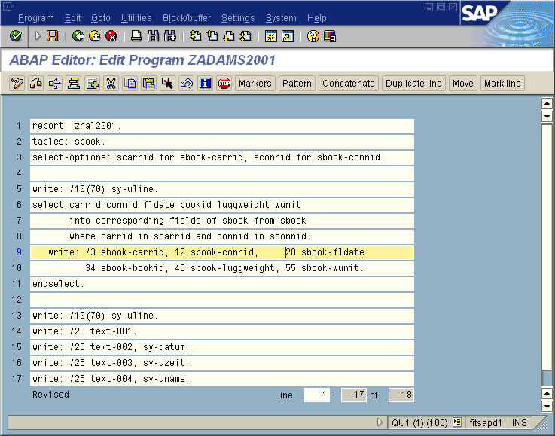
This is an example of some ABAP code that produces the report illustrated on the following slide.
In short:
the tables statement declares R/3 database tables that are to be made accessible to the report program;
the select-options statement creates the selection screen
the select statement retrieves data from the database
the write statement displays the output
* See ZADMS2001

Slide 84
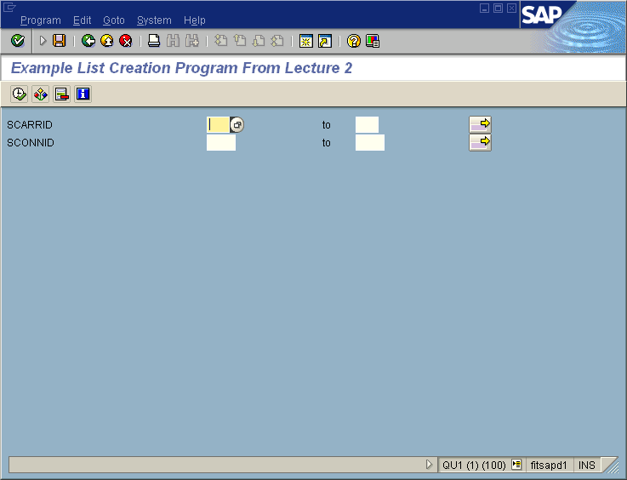
Notes:
Selection screen for the report

Slide 85
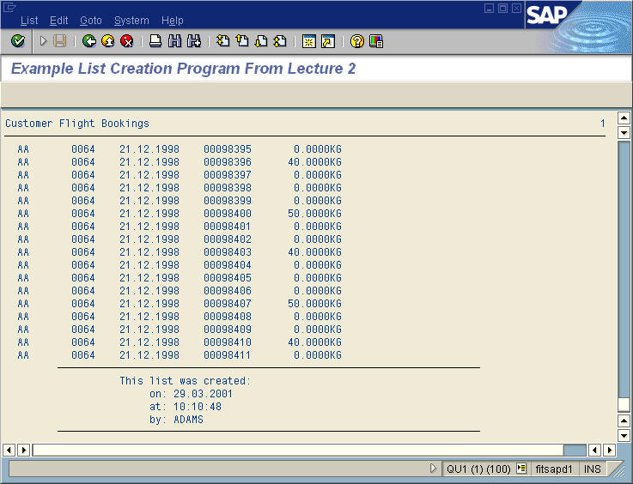

Slide 86
The Repository Information System
The Repository Information System is used to search for objects in the R/3 system and provides
  list of all objects X with attribute/s Y
  the Where Used List which gives a list of every place that object X is used throughout the R/3 system
  information about foreign key relationships between tables
  display of data (all records in table X with attribute Y)

Slide 87
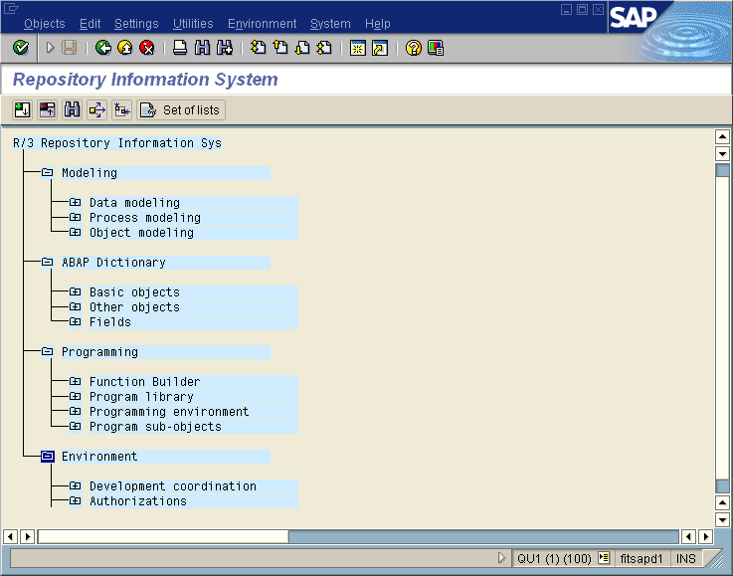

Slide 88
Test and Analysis Tools
ABAP Editor
  syntax checker
    tests for coding and syntactical correctness
    provides automatic ‘correct’ facility
    in case of an error, provides a detailed (although sometimes obscure) reason for the error
  extended syntax check
    searches out situations that might possibly result in a runtime error (eg, inconsistent interface parameters)
    warns about use of literals instead of text elements
Debugger
  finds logic errors
  provides ability to
    stop the program anywhere during runtime
    continue statement by statement
    skip over subroutines
    check or change the contents of variables and internal tables on the fly

Slide 89
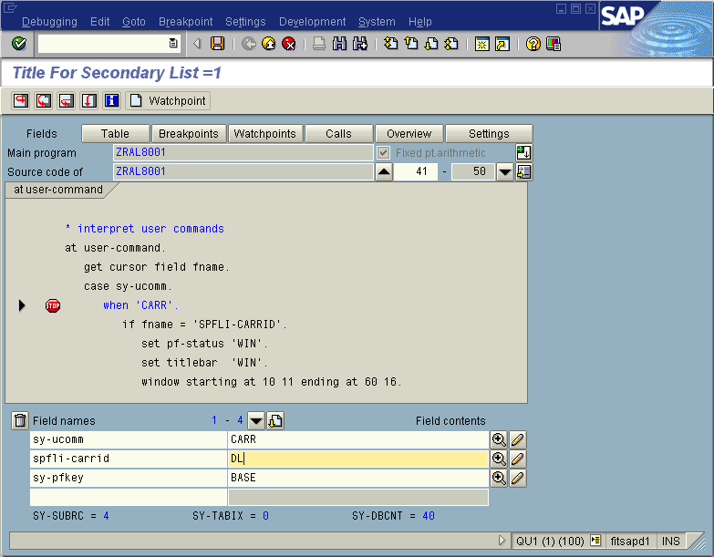
This is an example of a debugging session.
The debugger allows the user to type in the names of up to 4 variables. The debugger displays the current contents of these variables and updates the display as the values change during program execution.
The debugger provides facilities to execute in single step mode and to display the contents of internal tables.

Slide 90
Agenda
Topics we will be covering here:
Selection Screens
Reports / Interactive Reports
Logical Databases

Slide 91
Selection Screens

Slide 92
Selection Screen
Used by user to enter either a single value for a field or fields, or to enter selection criteria.
Defined using ABAP statements . Contains input fields, checkboxes, radio buttons for input and other features(pushbuttons,tabstrip control,subscreen etc)
You can create and save predefined sets of input values in the ABAP Editor for any selection screen. These are called variants.

Slide 93
Basic form
Syntax :PARAMETERS p.
Field used in selection screen , used for single entry .
Additions:
1. ... DEFAULT f
2. ... TYPE type
3. ... DECIMALS dec
4. ... LIKE g
5. ... MEMORY ID pid
6. ... MATCHCODE OBJECT mobj
7. ... MODIF ID modid
8. ... NO-DISPLAY
9. ... LOWER CASE
10. ... OBLIGATORY
11. ... AS CHECKBOX
12. ... RADIOBUTTON GROUP radi
13. ... FOR TABLE dbtab
14. ... FOR NODE node
15. ... AS SEARCH PATTERN
16. ... VALUE-REQUEST
17. ... HELP-REQUEST
18. ... VISIBLE LENGTH vlen
19. ... VALUE CHECK
20. ... LIKE (g)
21. ... USER-COMMAND ucom

Slide 94
Additions | Significance
DEFAULT f | The parameter has the default value f.
TYPE type | The field in the program has the type type.
DECIMALS dec | defined with dec decimal places with parameters of type P
LIKE g | Creates the field p with the same attributes as the field g, which has already been declared. g can be an ABAP Dictionary field, or a field in the program that has already been declared.
MEMORY ID pid | Assigns the memory ID pid to the parameter . When selection screen appears ,The input field contains the last value entered by the user in a field with memory ID pid.
Matchcode object mboj | Attaches search help mobj with parameter
Modif id modid | Makes screen-group1 = modid for the parameter Which is used in modifying selection screen

Slide 95
No-display | Parameter is not displayed on selection screen
Lower case | Allows case sensitive input
Obligatory | User must enter a value
As checkbox | Shows a parameter of c1 datatype as checkbox
Radiobutton group g1 | Forms a radiobutton along with other radiobutton parameters of same group g1
Visible length vlen | The visible length for the parameter in the screen is of vlen characters
User-command ucomm | Valid for radiobutton or checkboxes only .On clicking them , the user command ucomm is executed

Slide 96
Modifying Selection Screens By Modif Id
REPORT YMOD .
PARAMETERS: TEST1(10) MODIF ID SC1,
TEST2(10) .
AT SELECTION-SCREEN OUTPUT.
LOOP AT SCREEN.
IF SCREEN-GROUP1 = 'SC1'.
IF TEST2 = ‘INDIA’ .SCREEN-INTENSIFIED = '1'. Else . Screen-intensified = 0 . ENDIF .
MODIFY SCREEN.
CONTINUE.
ENDIF.

Slide 97
SELECT-OPTIONS
Internal table object of the standard table type that has a standard key and a header line.
Used to store complex selections using a standardized procedure.
Mainly used to directly translate the selection criteria into database selections using the WHERE.

Slide 98
Structure of Selection Tables
Row type of a selection table is a structure that consists of the following four components: SIGN, OPTION, LOW and HIGH.
HIGH : Specifies the upper limit for a range selection
LOW : Defines single field comparison when HIGH is empty/defines lower limit of selection when HIGH is not empty.
SIGN : Decides whether the result of the row condition is to be included in or excluded from the resulting set of all rows. Possible values are I(Inclusive) and E(Exclusive).
OPTION : Operators EQ, NE, GT, LE, LT,CP, and NP can be used if HIGH is empty , else only BT and NB can be used .

Slide 99
Syntax :
SELECT-OPTIONS <seltab> FOR <f > [DEFAULT <g> [TO <h>] ] [OPTION <op>] [SIGN <s>] [NO-EXTENSION] [NO INTERVALS ] [MEMORY ID <pid>] [LOWER CASE] [OBLIGATORY] [NO DISPLAY] [MODIF ID <SC1>]
No-extension is used to restrict multiple row entry by suppressing the pushbutton for the selection screen.No intervals is used to suppress the upper limit field .

Slide 100
FORMATTING SELECTION SCREENS
Putting Blank Lines : SELECTION-SCREEN SKIP <n>
Underlines
To place underlines on the selection screen:
SELECTION-SCREEN ULINE [[/]<pos(len)>] [MODIF ID <key>].
For <pos>, one can specify a number or either one of the expressions POS_LOW and POS_HIGH. POS_LOW and POS_HIGH mark the positions of the two input fields of a selection criterion.

Slide 101
Blocks of Elements
SELECTION-SCREEN BEGIN OF BLOCK <block>
[WITH FRAME [TITLE <title>]]
[NO INTERVALS].
…
SELECTION-SCREEN END OF BLOCK <block>.
Blocks can be nested . WITH FRAME marks the block with a frame . TITLE addition assigns a title for the block .NO INTERVALS restricts all the select options within the block to single fields .
Putting Several Elements in a Single Line
SELECTION-SCREEN BEGIN OF LINE.
...
SELECTION-SCREEN END OF LINE.
This should be put inside a block

Slide 102
Comments
To place comments on the selection screen, you use:
SELECTION-SCREEN COMMENT [/]<pos(len)> <comm> [FOR FIELD <f>]
[MODIF ID <key>].
The <comm> comment is placed on the selection screen. A text symbol or a field name with a maximum length of eight characters in the INITIALIZATION block should contain the comment in <COMM>. Position(pos) and length(len) should always be mentioned . Only if there are several elements in one line, can you omit <pos>.
FOR FIELD <f> is used to assign a field label to the comment. <f> can be the name of a parameter or a selection criterion. As a result, if the user requests help on the comment on the selection screen, the help text for the assigned field <f> is displayed.
The MODIF ID <key> addition has the same function as for the PARAMETERS statement. You can use it to modify the comment before the selection screen is called.

Slide 103
PushButtons On Selection Screen
SELECTION SCREEN PUSHBUTTON [/]<pos(len)> <push> USER-COMMAND <ucom> [MODIF ID <key>].
<push> determines pushbutton text , which can be a text symbol , or a variable ( not declared by DATA statement), which is assigned in INITIALIZATION block .
When the user clicks the pushbutton on the selection screen, <ucom> is entered in the UCOMM of the SSCRFIELDS interface work area. SSCRFIELDS structure must be declared at the top using TABLES statement . The contents of the SSCRFIELDS-UCOMM field can be processed during the AT SELECTION-SCREEN event.

Slide 104
PushButton On Application ToolBar
Upto five pushbuttons can be created in Application Toolbar .
Syntax : SELECTION-SCREEN FUNCTION KEY <i>.
<i> must be between 1 and 5. SSCRFIELDS structure must be declared by TABLES statement in the program .In the INITIALIZATION block , one must define the title of the pushbutton by assigning them to sscrfields-functxt_0<i> .
If the user clicks a pushbutton, function code FC0<i> of component UCOMM is assigned to structure SSCRFIELDS. The function code can be analyzed during the AT SELECTION-SCREEN event.

Slide 105
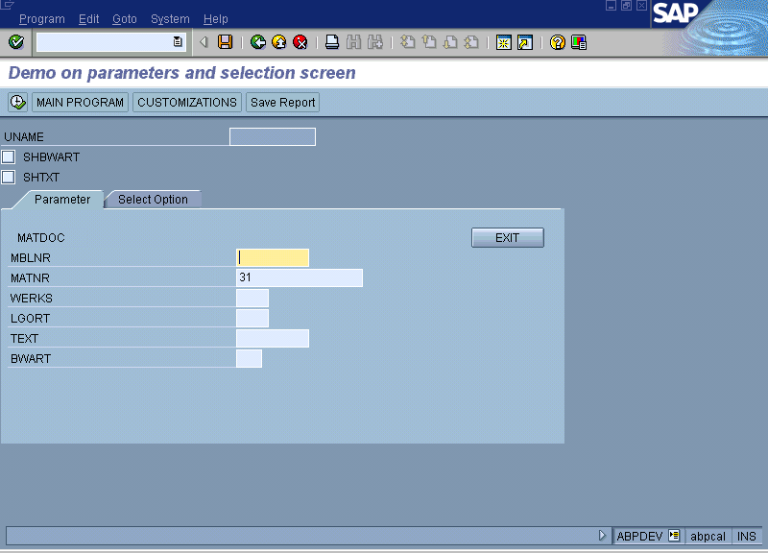
Subscreens and Tabstrip Controls in Selection-Screen

Slide 106
Reports

Slide 107
Topics
Types of reports
Menu Painter
Calling Programs
Printing and Saving Lists

Slide 108
Types of Reports
Classical Reports
  Reports which are properly formatted (header, footer, page numbers etc.,) with the help of one or more external events like top-of-page,end-of-page etc., are called as CLASSICAL REPORTS.
Standard list.
  Output of Report program is nothing but Standard list. It consists of one continuous page of 60,000 lines.
Interactive Reports
  Reports which permit user interaction

Slide 109
Report Statement - Options
To restrict the number of lines per page
Report Zxxxxx line-count 25.
OR
Report Zxxxxx line-count 25(3).
( In this case 3 lines are reserved for footer)
To Restrict Output Width
Report Zxxxx line-size 125.
To restrict the standard page heading
Report Zxxxx no standard page heading.

Slide 110
Event-driven programming language
ABAP is an event-driven programming language. The general flow of an ABAP program is controlled by events. These events are defined in an ABAP program using event keywords. All statements between event keywords or between an event keyword and a FORM statement form processing blocks.
For clarity of reading code, it is good programming practice to code event processing blocks in the order in which they will be triggered during execution. However, they do not have to be coded in a sequential order. Within an ABAP Processing Block, statements are processed sequentially (top to bottom).
In the next example the statements of the START-OF-SELECTION event are processed first, then the statements of the processing block GET BSIK. Finally, the code in the END-OF-SELECTION processing block is executed.
All ABAP statements that are not written as part of a processing block (after an event keyword) or a FORM-ENDFORM block are automatically part of the Start-of Selection processing block if they are coded above all other event keywords or subroutines.
On the following pages, we’ll examine system-triggered events which occur during the runtime of a report program . These events are presented in the order in which they are processed. Let’s call them runtime events.

Slide 111
ABAP Event-Driven Programming
Program Code Program List
Flow Produced
REPORT ZPB001.
TABLES: BSIK.
DATA: VAR1(4) VALUE ‘0001’.
GET BSIK.
IF SY-LINNO < 5.
WRITE: / BSIK-LIFNR, VAR1.
ENDIF.
END-OF-SELECTION.
WRITE: / ‘END-OF-SELECTION’,
‘has occurred’.
START-OF-SELECTION.
WRITE: / ‘START-OF-SELECTION’,
‘has occurred’.
Program Header
START-OF-SELECTION has occurred
100000 0001
END-OF-SELECTION has occurred
2
3
1

Slide 112
Events In Classical Reports
Initialization.
At selection-screen. Screen Events
Start-of-selection.
Top-of-page.
End-of-page. List Events
End-of-selection.

Slide 113


Runtime Event INITIALIZATION
If a report has a selection screen defined (either explicitly or by default through the use of a logical database), the ABAP processor processes the selection screen first. A programmer can execute another block of code before the selection screen by using the event keyword INITIALIZATION. This processing block can be used to define characteristics of the selection screen. Examples include: setting default values on selection fields, setting a titlebar, assigning text to pushbuttons, etc.
Execute a processing block
before the selection screen

Slide 114

Runtime Event AT SELECTION-SCREEN
AT SELECTION-SCREEN occurs when the user triggers a function code on the selection screen (i.e., by clicking on push-button, hitting a function key, etc.). Checks can be made on selection screen fields and appropriate messages sent back to the user (error, confirmation, warning messages), or the program can be terminated.
After the user enters new information, AT SELECTION-SCREEN is
triggered again.
Trigger a function code
on the selection screen

Slide 115

Runtime Event START-OF-SELECTION
START-OF-SELECTION is triggered after the selection screen is processed, and before any GET events or any other event processing blocks.
If no event keywords are coded in a report program, the report statement automatically starts START-OF-SELECTION processing (it can be explicitly coded, but need not be).
All ABAP statements that are not part of a processing block (after an event keyword) or a FORM-ENDFORM block are automatically part of the START-OF-SELECTION processing block if they are coded above all other event keywords or subroutines.
START-OF-SELECTION can be used to set default values of program-defined variables, or to code WRITE statements to be output to the screen.
Can be coded explicitly, but
need not be.

Slide 116

Runtime Event END-OF-SELECTION
END-OF-SELECTION is the last system event to be processed during the runtime of a report program. It occurs after all logical database records have been read, and before any user-invoked events.
END-OF-SELECTION occurs only once.
The next set of events we’ll consider occur while the ABAP processor is processing the output list of a report program. Let’s call them output events.
Last system event to occur;
Occurs only once

Slide 117
Output Event TOP-OF-PAGE
TOP-OF-PAGE is used for page headers on the basic list only.
TOP-OF-PAGE is triggered when the system encounters a WRITE, SKIP,
or ULINE statement on the basic list.
TOP-OF-PAGE occurs the moment the first line of the first page is written
to the screen.
NEW-PAGE also invokes the TOP-OF-PAGE event.
Used for page headers
for the basic list only

Slide 118

Output Event END-OF-PAGE
The END-OF-PAGE event is used for page footers.
This event is triggered when the system encounters insufficient space on the current output page. The LINE-COUNT statement within the REPORT statement specifies the size of the page area. If a LINE-COUNT is not explicitly coded, the END-OF-PAGE event block will not be processed.
  Proper usage of LINE-COUNT is to include the number of lines per page, as well as how many lines are reserved for the footer.
  For example, the following statement will display 50 lines of output, and then 3 lines of footer information.
  REPORT YPROG LINE-COUNT 53(3)
Used for page footers

Slide 119
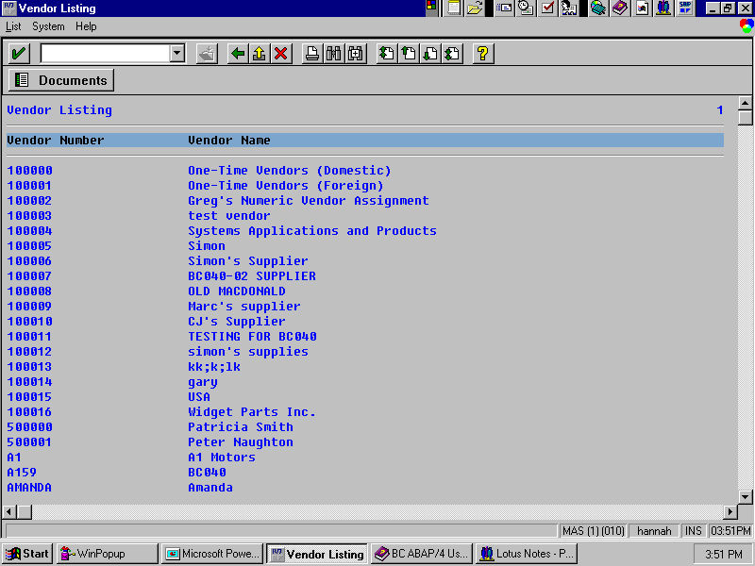
When is a List Displayed?
The basic list is displayed after all system-triggered events that are coded are executed:
  INITIALIZATION.
  AT SELECTION-SCREEN.
  START-OF-SELECTION.
  GET <table>.
  GET <table> LATE.
  END-OF-SELECTION.
  TOP-OF-PAGE.
  END-OF-PAGE.

Slide 120
Interactive Reports

Slide 121
Agenda
Events used in Interactive Lists
Menu Painter
Hide Technique
System Fields

Slide 122
Interactive Reports - Concept
Let’s suppose that you are the manager of a large sales organization at the XYZ Corporation. Every Monday morning a 100 page “sales order report” is delivered to your desk. This report lists the individual sales orders created by your department for the last week. The orders are listed numerically and contain general information, as well as detailed information about the orders including: sold-to party, order date, delivery date, sales representative responsible, items ordered, and order quantity.
As a manager you are interested in both general or summarized information about the sales orders, as well as the detailed information about particular orders. You may want the report sorted by various criteria such as by sales regions or by sales representatives. Additionally you may want to see detailed order information such as items ordered and order quantities, or even customer address information. A report containing all of this information would be quite long, becoming cumbersome and confusing to search through. In order to alleviate this problem you may want to be presented with the high level information and wish that you could somehow “interact” with the report, sorting it by the desired criteria or narrowing its scope so that you are presented only with the detailed data that you are interested in.

Slide 123
Interactive Reports - Concept
ABAP/4 proposes its interactive reporting feature as the solution to the problem described on the previous page. As an ABAP/ 4 programmer you are able to design reports that elicit or “prompt” responses from the user, allowing the user
to “interact” with the report (through the use of the mouse or function keys).
As a Sales Manager of the XYZ Corporation you can now execute an interactive report that provides you with a list of high level information and sales orders listed by number. You can then “interact” with the report to either sort it or obtain detail information.
These interactive reports first provide a basic list, that contains the high level information the user requires, then upon user-interaction displays detail lists, that contain user-requested information. These user-interactions will raise
ABAP/4 events that will invoke the code or processing block that follows
an event key word.

Slide 124
Interactive Reports - Events
Events used in Interactive reports:
At Line-Selection
At User-Command
AT PF-Key.
Top-of-page During line-selection

Slide 125

List Display Event AT LINE-SELECTION
The event AT LINE-SELECTION is triggered when the user selects a line and invokes the PICK function code.
This can occur when the user:
  Double-clicks on a line
  Single clicks on a line and presses F2
  Single clicks on a line and presses a PICK push-button on the list
PICK
Triggered by function code:

Slide 126
List Display Event AT USER-COMMAND
The AT USER-COMMAND event is triggered when the user invokes any function code except PICK.
The function code can be up to 20 characters long.
This function code can be assigned to a push-button, menu item, or function key on the keyboard.
All Others
besides
PICK
Triggered by function code:

Slide 127
Output Event TOP-OF-PAGE DURING LINE-SELECTION
TOP-OF-PAGE DURING LINE-SELECTION allows a programmer to display headers for detail lists (other than the basic list).
TOP-OF-PAGE DURING LINE-SELECTION is triggered with a WRITE, SKIP or ULINE statement on a detail list.
Used for page headers
on detail lists

Slide 128
Menu Painter

Slide 129
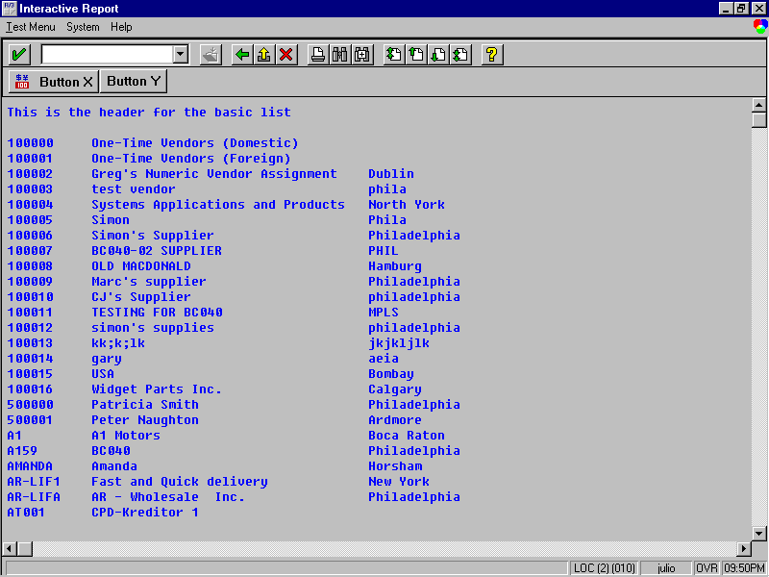
Graphical User Interface (GUI)
In this chapter, we will cover the concept of a graphical user interface (GUI) for an interactive report.
  All ABAP report programs run with a default GUI status assigned by the system (use the menu path “System→Status” and look at the GUI status field).
  You can create a custom GUI for your interactive report programs.
In all programs, the GUI refers to five components:
  Function key assignments, Standard toolbar, Application toolbar, Menubar, Titlebar
A program’s GUI is created in the Menu Painter (menu path “Development→ Menu painter” or transaction code “SE41”).
Titlebar
Menubar
Application
Toolbar
Standard
Toolbar

Slide 130

Menu Painter
Each program has a single GUI that contains the defined function codes. A function code is a twenty-character (maximum) identifier that can be assigned to function keys, the standard toolbar, the application toolbar, and the menubar. However, in the case of interactive reporting, there is a maximum of ten characters that can be given to a function code.
  It is the function code that you will use to determine which function key the user pressed, which pushbutton the user clicked on, or which menu path the user chose.
A GUI is made up of one or many statuses. It is a GUI status that you will set for a particular list(s).
  It is important to know that a function code created on one GUI status is part of the whole GUI; therefore, it is available in all of the GUI’s statuses.
Another aspect of a GUI is the titlebar. You can define any number of titlebars for a particular GUI.
In SAP version 3.0, function codes were only four characters long.
Menu Painter
Creates function codes
Function Key
Assignments
Standard
Toolbar
Application
Toolbar
Menubar

Slide 131
A GUI Status
Virtually all interactive reports consist of the following three components illustrated on the next few pages:
1. The GUI Status (Graphical User Interface Status): what the user will actually see when they are interacting with your program.
  All ABAP report programs run with a default GUI status assigned by the system
  To create your own buttons and menus for your program you will have to create a custom GUI Status.
  A typical GUI Status will contain buttons and menus that the programmer has created.
1. The GUI Status (Graphical User Interface Status)
Programmer Defined Buttons and Menus
l In this sample GUI Status, the programmer decided to create a “DOCUMENTS” button, and a “LIST” menu.

Slide 132

A GUI Title
2. The GUI Title (Graphical User Interface Title)
  The title bar of the window that you will use to display your report can be customised as well.
2. The GUI Title (Graphical User Interface Title)
Programmer defined titlebar

Slide 133

ABAP Code
3. The ABAP code
  This code must be capable of “communicating” or “interacting” with the user.
  Consider this … how does your code know what the user is doing?
    Example: Did the user just click on the DOCUMENTS button, or did they select the LIST menu? Maybe the user did not use the buttons or the menu at all, instead the user pressed the F6 function key on the keyboard.
    How can we, as programmers, keep track of all of these “events” that a user can initiate?
  From this point forward we will refer to the “act of the user”:
    1. Clicking a button on our GUI Status
    2. Selecting a menu from our GUI Status
    3. Pressing a function key on the keyboard
  … can all invoke function codes which trigger User Events (or list display events).
3. The ABAP code
TABLES: LFA1.
START-OF-SELECTION.
SET PF-STATUS ‘TEST1’.
SELECT * FROM LFA1.
WRITE: / LFA1-LIFNR, 30 LFA1-NAME1.
ENDSELECT.
AT USER-COMMAND.
CASE SY-UCOMM.
WHEN ‘RUNX’.
SET PF-STATUS ‘TEST2’.
SET TITLEBAR ‘TB2’.
WHEN ‘RUNY’.
. . . .
ENDCASE.
SELECT *
CHECK
SY-SUBRC
Notes:
Coding Recommendation:
Logically there should be some code between the statements SET TITLEBAR ‘TB2’ and
WHEN ‘RUNY’ in order to produce output.

Slide 134
The AT USER-COMMAND Event
Any other function code (up to 20 characters long) except PF## and PICK triggers the AT USER-COMMAND event. ABAP programmers use the AT USER-COMMAND to find out how the user is interacting with the GUI Status.
  Whenever a user clicks on a pushbutton, selects a menu item, or presses a function key to which a function code other than PF## and PICK is assigned, the code that the programmer typed in the AT USER-COMMAND event module executes. This code could look something like the illustration
  shown above.
The following pages contain additional illustrations that explain how the AT USER-COMMAND event works.
*--begin of AT USER-COMMAND event--------------------------------
AT USER-COMMAND.
WRITE: / ‘The user just clicked on a pushbutton, selected’,
/ ‘a menu path, or pressed a function key’.
*--end of AT USER-COMMAND event-----------------------------------
Do not write this code, we will learn the
complete syntax momentarily.
A New
ABAP
Event
SYNTAX: AT USER-COMMAND.
Notes:
In SAP version 3.0, function codes were only four characters long.

Slide 135
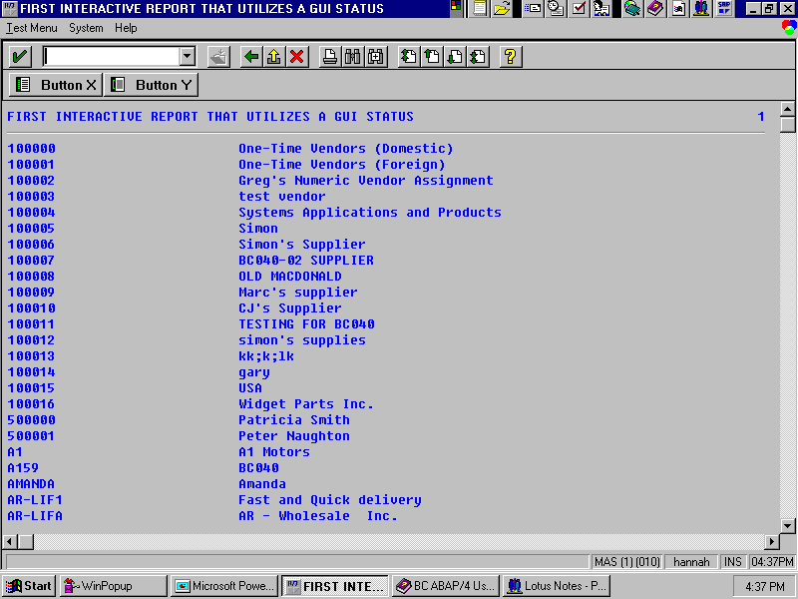
Activating the AT USER-COMMAND Event
Assume that the programmer who created this GUI status decided to put two buttons on this detail list: “Button X” and “Button Y”.
Assume further that this programmer assigned the 4-byte function codes “RUNX” and “RUNY”, respectively, to these buttons.
OK, we know that the AT USER-COMMAND event occurs when the user clicks on a pushbutton, selects a menu item, or presses a function key to which a function code other than PF## and PICK has been assigned. But exactly which button or menu item was chosen? We answer this question on the next page.
1st.
The user clicks on a button that the programmer created on the GUI Status.
2nd.
The system detects that ‘RUNY’ has been assigned as the function code behind this button.
3rd.
Behind the scenes, the ABAP processor reacts and triggers the AT USER-COMMAND event.

Slide 136
The SY-UCOMM System Field
If you really consider this concept you’ll discover that there is one problem. When the user triggers the AT USER-COMMAND all we know is that the user commanded “something”. Sure, the user triggered the AT USER-COMMAND event, but which button or menu did the user select? The answer is … we won’t know until we check the system field SY-UCOMM.
When you create a GUI Status each button and menu that you create must be given a unique “tag” up to ten bytes long called a function code. When the user clicks on a button, or selects a menu SY-UCOMM gets updated with this “tag”.
In the above example the programmer decided that Button X’s function code would be RUNX, and Button Y’s function code would be RUNY.
After SY-UCOMM gets updated, we can use CASE logic to determine which function code SY-UCOMM presently contains. There is an example of this provided on the next page.
Note: SY-UCOMM is updated when any user event is triggered (i.e. when AT USER-COMMAND, AT PF##, or AT LINE-SELECTION is triggered).
A New
ABAP
System Field
1st.
The user clicks on a button
that the programmer created
on the GUI Status.
2nd.
The SY-UCOMM
system field is
updated with the
four byte “tag” RUNY
3rd.
Behind the scenes, the ABAP processor reacts and triggers
the AT USER-COMMAND event.
SYSTEM FIELD: SY-UCOMM

Slide 137
Using AT USER-COMMAND with the SY-UCOMM System Field
Now we have the ability to use a CASE statement to check the value of
SY-UCOMM, and consequently determine which button or menu was pressed. Our code might look something like above.
Now that you have a basic understanding of some of the concepts, let’s build an interactive report that utilises a GUI Status.
Must be in
all caps and
single quotes
*--BEGIN OF AT USER-COMMAND EVENT MODULE.--------------
AT USER-COMMAND.
CASE SY-UCOMM.
WHEN ‘RUNX’.
WRITE: / ‘The user just pressed button X’.
WHEN ‘RUNY’.
WRITE: / ‘The user just pressed button Y’.
ENDCASE.
*--END OF AT USER-COMMAND EVENT MODULE.----------------

Slide 138
Interactive Report that Utilises a GUI Status
Let’s build our first interactive report that utilises a GUI Status.
We will call this GUI Status ‘TEST1’. TEST1 will contain two buttons, BUTTON X, and BUTTON Y. The unique ten byte “tag” (function code) for BUTTON X will be RUNX, the unique ten byte “tag” (function code) for BUTTON Y will be RUNY.
Our GUI Status will also contain our own menu, TEST MENU. This menu will contain two menu items: Item X , and Item Y. The menus will duplicate the functionality of our buttons.
User clicks on BUTTON X or menu Item X:
  A detail list window will “pop-up” that contains the text “The user chose X”.
  Remember the WINDOW STARTING AT <# #> ENDING AT <# #> statement?
When the user clicks on BUTTON Y or menu Item Y, a window will “pop-up” that contains the text “The user chose Y”
This is what our first interactive report, that utilises a GUI status, will look like.
A programmer defined a menu
containing two menu items,
(menu Item X, and menu
Item Y), will duplicate the
functionality of our buttons.
Two programmer defined buttons,
BUTTON X, and BUTTON Y.

Slide 139
Coding Example
Using SET PF-STATUS and Creating a GUI Status
To assign a custom GUI status to a list in an interactive report, use the following statement:
  SET PF-STATUS ‘<status name>’.
  The <status name> can be up to 20 characters.
  The <status name> must be in capital letters.
There can be many “statuses” in the GUI of your program. Each status describes which function codes are available and how you can select the function codes via menus, buttons, or function keys. We’ll see how shortly.
Create a new program and call it YGUI1-XX, (where XX is your user id).
Write the code that you see above.
After you have completed writing the code, follow the step-by-step instructions listed on the following pages.
In 3.0, function codes were a maximum of eight characters.
A New
ABAP
Reserved Word
TABLES: LFA1.
START-OF-SELECTION.
SELECT * FROM LFA1.
WRITE: / LFA1-LIFNR, 30 LFA1-NAME1.
ENDSELECT.
SET PF-STATUS ‘TEST1’.
SELECT *
CHECK
SY-SUBRC
SYNTAX: SET PF-STATUS <status name>.
Notes:
Coding Recommendation:
A good coding recommendation would be to set the PF-STATUS before any WRITE, SKIP, or
ULINE statements so that your TOP-OF-PAGE and TOP-OF-PAGE DURING LINE-SELECTION
events don’t use a previous PF-STATUS to determine what header to write out to the list.

Slide 140
Double Clicking GUI Status Name
1. In the code that you just typed, double-click on the word ‘TEST1’.
  You will probably get a message asking if you want to save your work. If so choose Yes.
  Begin the process of creating a GUI Status called TEST1.
    We will momentarily leave the ABAP Editor, and enter the “Maintain Status of Interface YGU1-XX” section of the Menu Painter. We will actually create the GUI Status TEST1 here.
  After the GUI Status is created we will return to the ABAP Editor and complete our code.
REPORT YGUI1-XX.
TABLES: LFA1.
START-OF-SELECTION.
SELECT * FROM LFA1.
WRITE: / LFA1-LIFNR, 30 LFA1-NAME1.
ENDSELECT.
SET PF-STATUS ‘TEST1’.
CHECK
Double-click on the
word ‘TEST1’.
SELECT *
SY-SUBRC
Notes:
Coding Recommendation:
A good coding recommendation would be to set the PF-STATUS before any WRITE, SKIP, or
ULINE statements so that your TOP-OF-PAGE and TOP-OF-PAGE DURING LINE-SELECTION
events don’t use a previous PF-STATUS to determine what header to write out to the list.

Slide 141
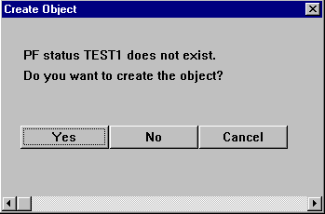
Letting the System Create the GUI Status
2. You will then be presented with the above dialog box. Choose Yes.
Choose YES

Slide 142
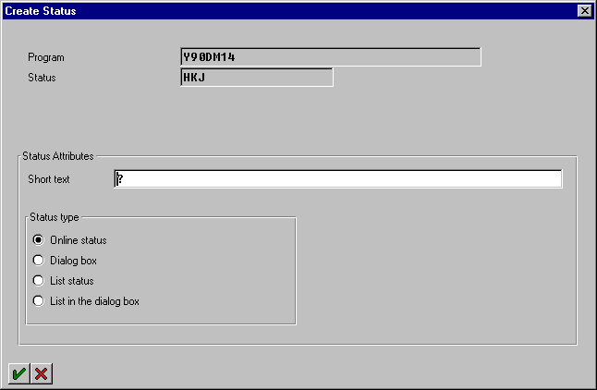
Entering Administrative Information
3. ABAP will present you with the dialog box shown above.
  Enter some descriptive text into the Short text field
    Choose List Status as the Status Type
    Click on the green check mark to complete this step
  In interactive reporting, you will be choosing between the “List Status” status type and the “List in the dialog box” status type.
    If you are going to assign the GUI status to a full-size list, the GUI status should be a “List” type status.
    If you are going to assign the GUI status to a sized-down window (using the “WINDOW STARTING AT” statement), the GUI status should be a “List in dialog box” type status.
  Status Types:
    Online Status – Can contain menus, standard toolbar, and application toolbar (no default function codes are specified)
    dialog box – No menu bar, no standard toolbar, does have an application toolbar (no default function codes are specified)
    List status – Can contain menus, standard toolbar, and application toolbar (default function codes are specified)
    List in the dialog box – No menu bar, no standard toolbar, does have an application toolbar (default function codes are specified)
Enter some descriptive text.
Choose “LIST” as the
status type.
Notes:
In SAP 3.0, List Status and List in the Dialog box were called List and List in Dialog Box.

Slide 143
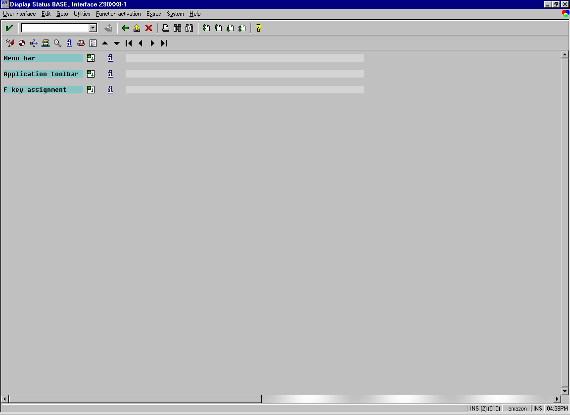
Menu Painter Initial Display
4. You will be presented with the following screen. This is where ABAP programmers define the function codes associated with the function keys, menus and pushbuttons that will be used to update SY-UCOMM.
Use the drop-down button to get the function code interface seen on the next page.
You create the menus
that will appear on the
menu bar of your GUI
Status by using these
white text boxes.
You create the buttons
that will appear on the
application toolbar of
your GUI Status by using
these white text boxes.
The buttons that will appear on your Standard toolbar and the function key assignments for all buttons are shown here.
Use the drop-down button to get the function code interface

Slide 144
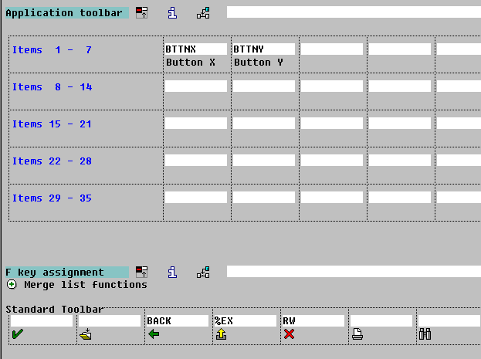
Expanding Menu Painter Display
5. Open the ‘F key assignment’ menu so that you can see the Standard toolbar.
  Function codes assigned to the standard toolbar of the GUI Status will allow buttons to appear on the standard toolbar.
  Those that are assigned to the application toolbar of the GUI Status will allow buttons to appear on the application toolbar.
To assign a function code to a pushbutton on either toolbar, the function code must be assigned to a function key (see next page).
If SAP’s default function codes (e.g.: BACK, %EX, RW) do not appear in the standard toolbar, click on the “Merge list functions” icon.
Application Toolbar in the Menu Painter
Standard Toolbar in the Menu Painter
Standard Toolbar
of your program
Application Toolbar
of your program

Slide 145
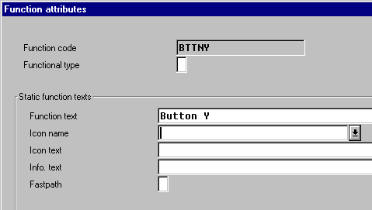
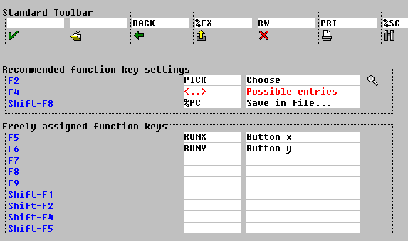
Assigning Function Codes to Function Keys
6. To assign a function code to a function key, click once inside the white text box (as shown above).
  We will specify a function code that will be used for BUTTON X here. We can also specify that our button will include an icon.
  Notice that our function code is being assigned to the F6 function key - one of the available function keys.
  Follow the steps above to create BUTTON X’s function code with an icon.
SY-UCOMM will get updated with this value every time the user clicks on BUTTON X or it corresponding menu Item.
Function codes can be created without icons associated to them. In this case, just enter the function code in the white box shown above. Then, enter this function code’s text in the white text box beside it.
To make sure you are seeing all 20 characters of a function code in Menu Painter, go to Utilities → Settings → User-Specific and make sure it says 20.
To create a function code with an icon associated to it, double-click on the function code, then choose an icon.
2nd.
1st.
Click once here. This is where we will define our first function code.

Slide 146
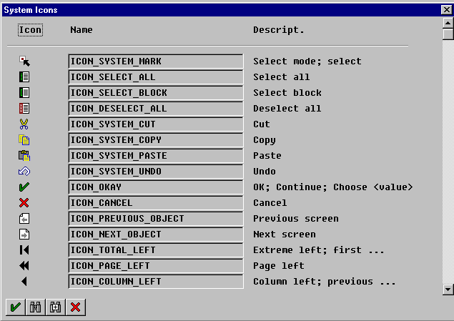
Adding an Icon to a Function Code
9. We are then presented with the above dialog box.
  This is where we get to choose the icon for what will become BUTTON X.
  Choose one.
  Unfortunately, you cannot create your own icons.
Choose any icon.

Slide 147
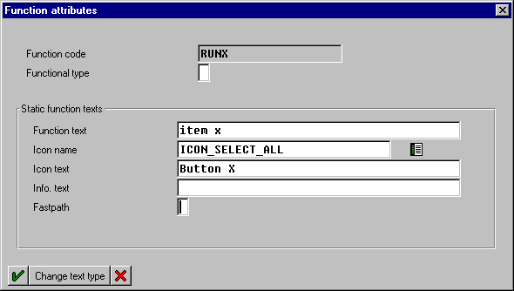
Function Code Attributes
10. Fill in the text fields as shown above. Then choose the green check mark
to complete the step.
  The function text helps the user determine the functionality of your button/menu.
    This text will show when the user pauses the mouse over your button.It is also the text that is expected to be used for the RUNX menu item.
  The “Icon text” is the text that will appear next to the icon on your button.
  Fast path designations will be created by the system automatically.

Slide 148
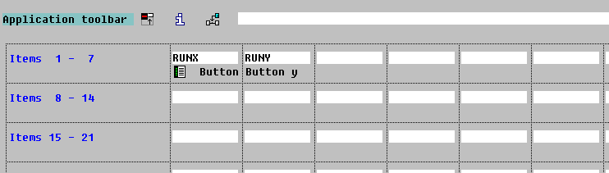
Creating Pushbuttons on the Application Toolbar
11 Next we will officially assign BUTTON X and BUTTON Y to the application toolbar of our GUI Status. Type the function codes (RUNX and RUNY) into the next available white text boxes on the application toolbar.
  If you create a GUI Status of the type LIST, you will always get a Print and a Find button on your toolbar. If you wish to remove these or any other function codes from the application or standard toolbar of your GUI status, you have two options:
    Click once on the function code, then use the menu path Edit®Entry ®Delete entry. This will remove the button from the toolbar, but not from the GUI status (i.e., this function code will still be able to be invoked from this GUI status because it will still be assigned to its appropriate function key).
    Click once on the function code, then click on the Active«Inactive button. This will both remove the button from the toolbar and remove it from the GUI status (i.e. this function code will not be able to be invoked from this GUI status).
Type the function codes (RUNX and RUNY) of your buttons into the next available white text boxes on the application toolbar. Click SAVE to see the icons appear below the white boxes.

Slide 149
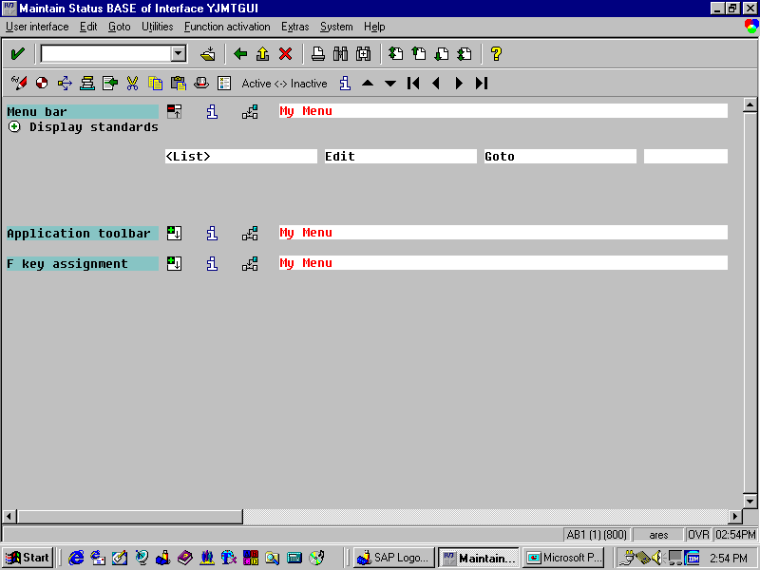
Adding a Menu
12. Next, we will create the menu.
To add the default < List >, Edit and Goto menus to the menu bar, click on the “Display Standards” icon. It is within the < List > block where you will maintain your customized menu assignments.
Select the first available white block for the menu bar, populated by <List > now, and type “Test Menu”.
  Even though you cannot see them here, Screen and List status types will always inherit the System and Help menus.
Select the first available white text box for the menu bar, now populated with <List> and type “Test Menu”. Double-click on this menu title to open it up (see next slide).

Slide 150
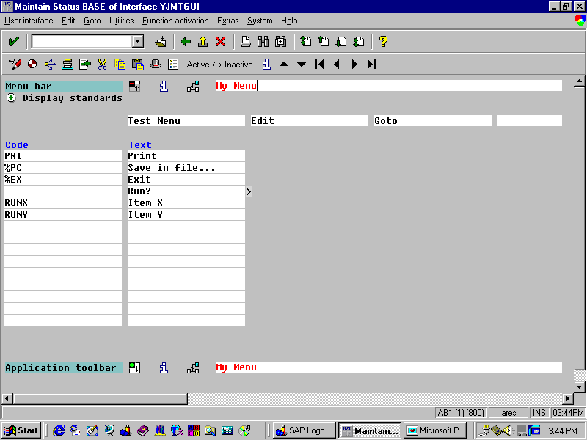
Adding a Menu Path
13. In order to create menu items (commands that will display themselves under
the “Test menu”) we must double-click on the words “Test Menu”.
  Additional white text boxes will appear under our “Test Menu”. This is where we create menu items.
  Type RUNX and RUNY in the available white text boxes in the
  left column.
  Fast path designations will be created by the system automatically.
TIP: If you wish to create a menu item with a
breakout (submenu), leave the entry in the Func.
column blank, and type a menu item name in the
Name column. Then type a function code in the
breakout menu which appears.
Type RUNX and RUNY here.

Slide 151
Automatic Recognition of Function Codes
14.Click on the save button. When you created the function codes (RUNX and
RUNY) you specified the Quick info/menu text. This text now
automatically appears in the column directly to the right of your menu item
names.
  Click on the generate button.
    You must GENERATE your GUI status.
  Your GUI Status “TEST1” has just been completed. Use the green back arrow to return to your code.
To view your GUI status before executing the program, use the “User interface → Test” menu path (or press the ‘F8’ key) in the Menu Painter.
You must generate the GUI.
When you click on the Save button (or press the ‘Enter’ key) the text associated to RUNX and RUNY are automatically displayed.

Slide 152
Using AT USER-COMMAND to Detect Function Codes
15. Let’s complete the code, by adding the lines indicated above.
  Generate your code.
  Before you execute your program, there is something to be on the lookout for when you run it.
  Take notice that when you click on the X or Y buttons, select the X or Y menu items, or press the associated function keys, the window that will be created “inherits” the GUI Status ‘TEST1’. That’s because unless you specify a new or different GUI Status for each screen/window that you create you will automatically get the GUI Status from the previous screen/window.
NOTE:
The function code in SY-UCOMM will always be in capital letters. Therefore, when you test SY-UCOMM with a CASE statement, you must capitalise the function code within the single quotes.
Enter this code for the “AT USER-COMMAND” event.
AT USER-COMMAND.
CASE SY-UCOMM.
WHEN ‘RUNX’.
WINDOW STARTING AT 10 4
ENDING AT 77 12.
WRITE: / ‘The user chose X’.
WHEN ‘RUNY’.
WINDOW STARTING AT 10 4
ENDING AT 77 12.
WRITE: / ‘The user chose Y’.
ENDCASE.

Slide 153
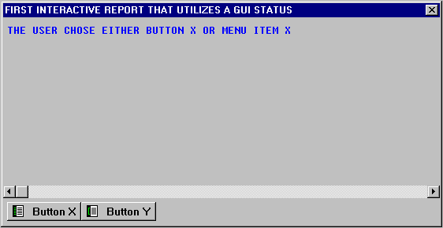
GUI Status for Detail Lists
In a moment you will execute this program, and when you do, you’ll notice that after you click on one of the buttons or menus this “inheritance” of the previous screen’s GUI Status creates a little problem.
Located above is the window that will be created when the user clicks on either the BUTTON X, selects the Menu Item X, or presses the ‘F5’ function key. Do you notice the problem with the GUI Status shown above?
Do you notice the problem with this GUI Status?

Slide 154
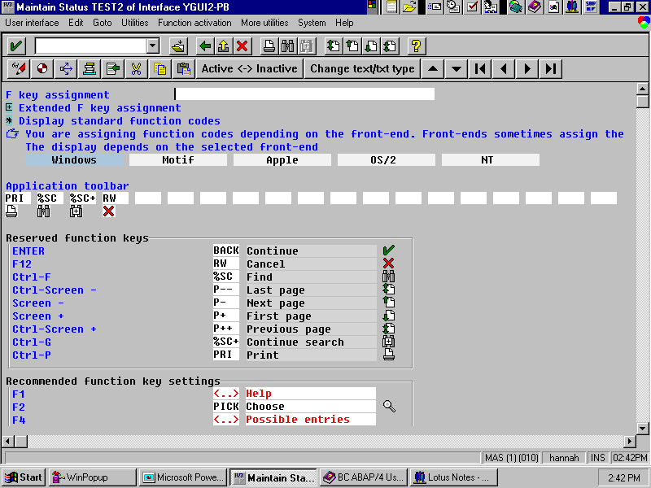
Problem with Detail List GUI Status
Remember to use the control menu box when you want to exit your window.
Problem:
How does the user exit this window?
There should be a button on the bottom of this window that allows the user to go back.
For now just use the control menu box to close this window.

Slide 155
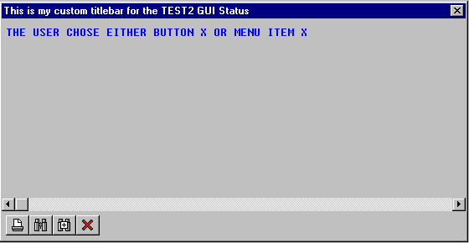
Using a Different GUI Status Type for Dialog Boxes
There are no practical limits on the number of GUI Statuses that you can create for your program. Typically each window/screen that you create should have it’s own GUI Status.
We will now enhance our current program so that when the user presses Button X or selects menu Item Y, the above GUI Status called ‘TEST2’ will appear.
NEW AND IMPROVED: TEST2
List in the dialog box GUI Statuses automatically contain a red cancel button.

Slide 156
A Report that Uses More than One GUI Status - Code
Now just as before, we will need to create the GUI Status ‘TEST2’. We will
follow virtually the same instructions that we used when we created the GUI
Status ‘TEST1’. However this time we will take advantage of a different type of GUI Status.
1. Add the code shown above. Then double-click on the word ‘TEST2’.
AT USER-COMMAND.
CASE SY-UCOMM.
WHEN ‘RUNX’.
SET PF-STATUS ‘TEST2’.
WINDOW STARTING AT 10 4
ENDING AT 77 12.
WRITE: / ‘The user chose X’.
WHEN ‘RUNY’.
WINDOW STARTING AT 10 4
ENDING AT 77 12.
WRITE: / ‘The user chose Y’.
ENDCASE.
Add this line of code. Then double-click on the word ‘TEST2’.

Slide 157
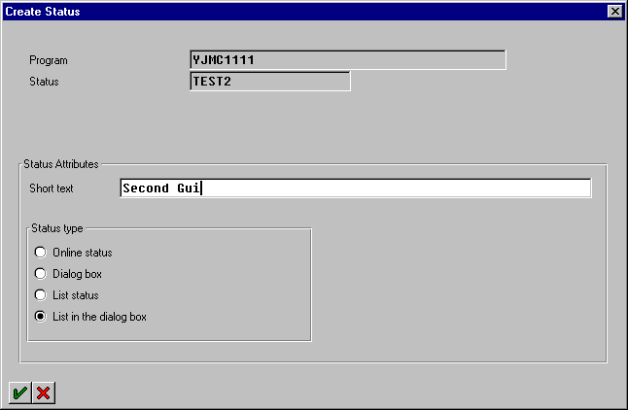
A Report that Uses More than One GUI Status Administrative
2. This time we will choose “List in the dialog box” as the status type because this GUI status will be assigned to a list that has been sized-down with the “WINDOW STARTING AT” command.
  Statuses of the type “List in dialog box” do not have menus or standard toolbars. They do, however, have CANCEL buttons as defaults
  on the application toolbar.
Add some descriptive text, then choose “List in the dialog box” as the Status Type.

Slide 158
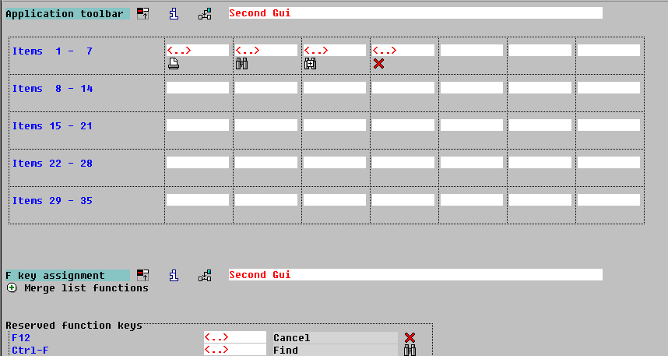
A Report that Uses More than One GUI Status - Menu Painter
3. Save and generate this status. Then return to your code.
  Notice that “List in dialog Box” statuses do not have menus or
  standard toolbars.
  By default “List in the dialog Box” statuses do have CANCEL buttons built-in on the application toolbar.
  There are many built-in function codes available to you. The ABAP processor will automatically recognise them if you enter them into an available white text box in the Menu Painter.
  The following page includes a chart that shows some of the built-in function codes that are available to you.
Notice that “List in dialog Box” statuses do not have menus or standard toolbars.

Slide 159
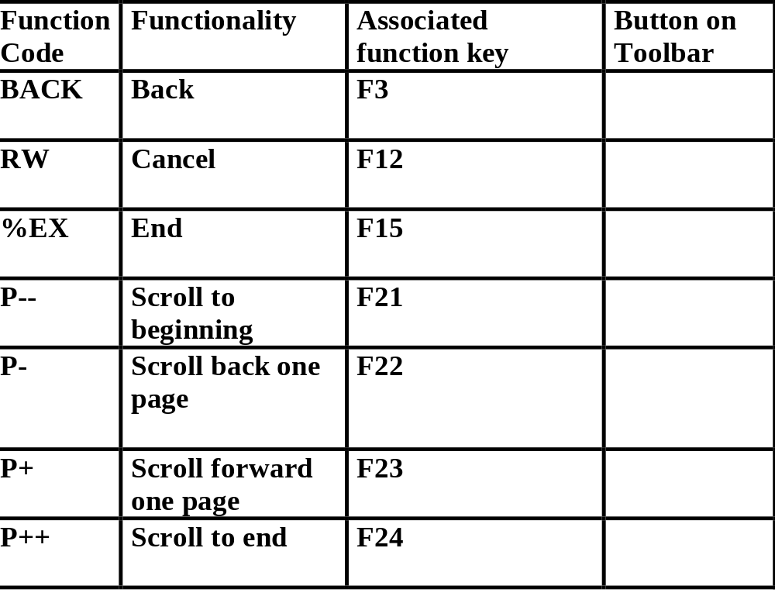
Function Codes Automatically
Recognised by ABAP

Slide 160
Coding Example
A Report that Uses More Than One GUI Status
For practice, change the CASE WHEN RUNY area of the code so that when the user clicks the BUTTON Y or selects the Menu item Y the GUI Status TEST3 shows. You’ll have to create the GUI Status TEST3. TEST3 should have the identical functionality of TEST2.
See above for the completed code.
AT USER-COMMAND.
CASE SY-UCOMM.
WHEN ‘RUNX’.
SET PF-STATUS ‘TEST2’.
WINDOW STARTING AT 10 4
ENDING AT 77 12.
WRITE: / ‘The user chose X’.
WHEN ‘RUNY’.
SET PF-STATUS ‘TEST3’.
WINDOW STARTING AT 10 4
ENDING AT 77 12.
WRITE: / ‘The user chose Y’.
ENDCASE.
Add this line of code.

Slide 161

The SY-PFKEY System Field
The ability to create applications that utilise more than one GUI Status will allow you to create much more complex and appealing applications.
SY-PFKEY contains the name of the current GUI status. SY-PFKEY is designed to help you manage the various GUI Statuses that your application uses.
SY-PFKEY can be checked with CASE and/or IF logic.
  Example:
  TOP-OF-PAGE DURING LINE-SELECTION.
  CASE SY-PFKEY.
  WHEN ‘TEST2’.
  WRITE: / ‘TEST2 Header’.
  WHEN ‘TEST3’.
  WRITE: / ‘TEST3 Header’.
  ENCASE.
  In this situation we use the system field SY-PFKEY to control the output of page headers in the TOP-OF-PAGE DURING LINE-SELECTION event.
Which status is currently being used?
A New
ABAP
System Field
SY-PFKEY = ‘TEST1’
SY-PFKEY = ‘TEST3’
SYSTEM FIELD: SY-PFKEY

Slide 162
Coding Example: Adding a GUI Title
As ABAP programmers, you also have the ability to change the text that appears in title bar of your GUI Status. SET TITLEBAR <titlebar name> is the ABAP reserved word that is used to assign a GUI Title to a list.
  The <titlebar name> can be up to 20 characters.
  The <titlebar name> must be in capital letters.
  A titlebar is not specific to one GUI status. Any titlebars you create can be used on any GUI status for your program.
  Like with a GUI status, a new list will “inherit” the titlebar from the previous list if a new one is not assigned.
Creating and assigning a GUI Title is very simple.
  1. Change the CASE ‘RUNX’ section of our code so that it looks as above.
  The new code begins and ends on line 22.
  2. Then double-click on the word ‘TB2 ’ (stands for titlebar 2).
A titlebar can use up to nine variables. The syntax is:
  SET TITLEBAR <titlebar name> WITH <var1> <var2> . . . <var9>.
  When you double-click on the name of your titlebar, indicate in the title input field the text for the title. An ampersand (&) is used in the title text as a placeholder for variables.
A New
ABAP
Reserved Word
AT USER-COMMAND.
CASE SY-UCOMM.
WHEN ‘RUNX’.
SET PF-STATUS ‘TEST2’.
SET TITLEBAR ‘TB2’.
WINDOW STARTING AT 10 4
ENDING AT 77 12.
WRITE: / ‘The user chose X’.
WHEN ‘RUNY’.
SET PF-STATUS ‘TEST3’.
WINDOW STARTING AT 10 4
ENDING AT 77 12.
WRITE: / ‘The user chose Y’.
ENDCASE.
SYNTAX: SET TITLEBAR <titlebar name>.

Slide 163
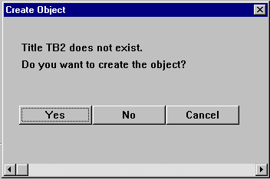
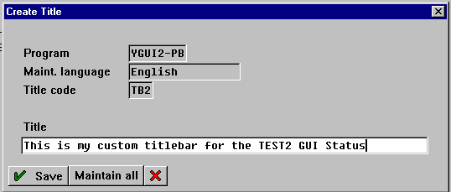
Adding A GUI Title - Administration
That’s all it takes to create your own GUI Title.
Generate and execute your code and test it out.
If you ever need to edit your GUI title just double click on it’s name.
First
Choose Yes.
Second
Type in the text that you
want to appear in the titlebar
of your GUI Status. Use ampersands (&) if you want to use variables. Then choose Save.

Slide 164
Graphical User Interface
It is important to remember the basic concept of a graphical user interface:
  Each program has a single GUI that contains the defined function codes.
  A function code is a four-character (maximum) identifier that can be
  assigned to function keys, the standard toolbar, the application toolbar,
  and the menubar.
    It is the function code that you will use to determine which function key the user pressed, which pushbutton the user clicked on, or which menu path the user chose.
    The valid function codes for the GUI above are RUNA, RUNB, RUNC, RUNX, RUNY, and RUNZ.
  A GUI is made up of one or many statuses. It is a GUI status that you will set for a particular list(s).
    It is important to know that a function code created on one GUI status
    is part of the whole GUI; therefore, it is available in all of the
    GUI’s statuses.
      For example, the RUNX, RUNY, and RUNZ function codes created on status 1 above are not only part of that GUI status, but also part of the entire GUI for the program.
      These function codes can be reused on any status created for the program’s GUI (i.e., RUNX is used on status 2 and RUNY is used on status 3).
    The function codes assigned to a particular GUI status determine what actions the user can take when that GUI status is set for a list(s).
Program’s GUI
Status 1
RUNX
RUNY
RUNZ
Status 2
RUNX
RUNA
Function Codes
for Entire GUI
RUNA
RUNB
RUNC
RUNX
RUNY
RUNZ
Status 3
RUNC
RUNY
Status 4
RUNB

Slide 165
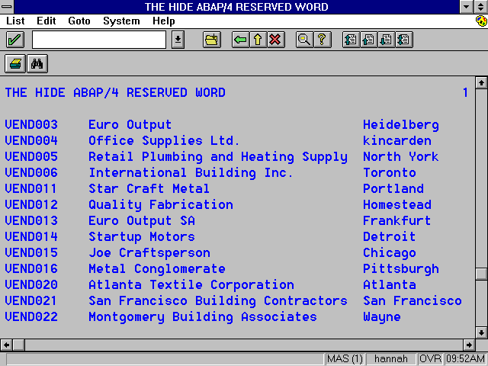
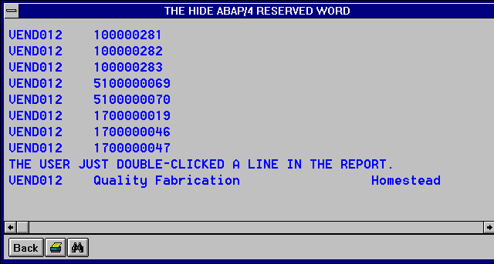
A “Drill Down” Screen
We will create the interactive report shown above.
In this example:
  The interactive report will display a simple list of vendors. The list will contain the vendor’s account number, name, and city.
  The user will select a particular vendor by double-clicking on it.
  Our interactive report will then react by creating an additional window (detail list) that contains the invoice numbers only for the selected vendor.
    Vendor invoices are stored in the BSIK table.
In order to provide this additional information, we will need to select corresponding information from another source: a database table.
  To do this, we’ll need access to the primary key of the record the user selected in order to select corresponding records from our data source and produce a detail list.
    One of the primary keys of the BSIK table is the vendor number field (BSIK-LIFNR).
So, our goal will be to find an event which responds to the user double-clicking on a line. Then, we’ll want to retrieve information from the record the user selected in order to do further processing.
  Keep in mind that the concepts learned in this chapter are not specific to the user double-clicking on a line. They are appropriate for any user
  event triggered.
First the user double-clicks on a record.
Then a “drill down” list is created showing data relevant to the record initially selected by the user.

Slide 166
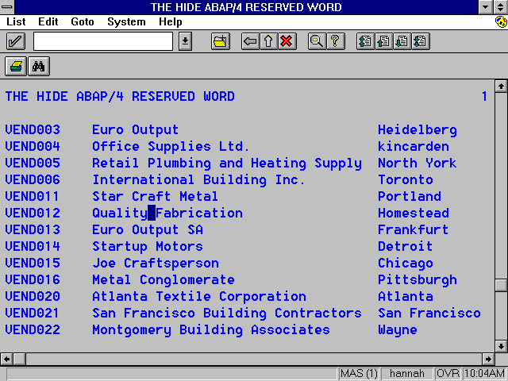
The Challenges
This is a pretty simple program, however, there are two areas of concern:
  1. How did the code “know” which record the user has selected?
    There could be literally hundreds of records in a given report and our code must have the capability to somehow determine the precise record selected by the user.
  2. Once we determine which record has been selected, how do we pass this record back to our ABAP code for processing?
    Processing, in this case, means that we will need to use the selected vendor number as criteria for an ABAP SELECT statement which will produce the detail list containing only the relevant invoice numbers.
To create this interactive report we need to learn new methods to overcome the challenges that are illustrated above.
First Challenge:
How did the ABAP code “know” when and which record the user has selected?
Second Challenge:
How is this record sent back as criteria to an ABAP SELECT statement?
SELECT * FROM BSIK WHERE LIFNR = <selected vendor number>.

Slide 167
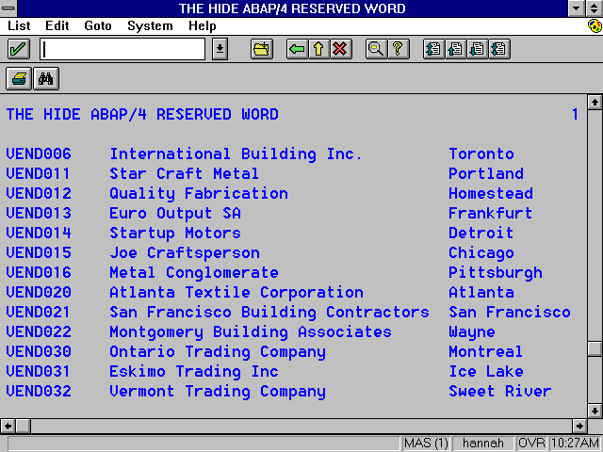
Illustration
(The AT LINE-SELECTION Event)
The AT LINE-SELECTION event occurs when the function code “PICK”
is invoked.
  When a user double-clicks on a line in the report, “PICK” is invoked.
AT LINE-SELECTION is also triggered by:
  A single click + F2 (because the system automatically assigns “PICK” to the ‘F2’ function key)
  A single click + a pushbutton assigned the “PICK” function code on the
  GUI status
Determining When the User Is Requesting
Additional Information
When the user double-clicks a line in the report, the “AT LINE-SELECTION” event occurs (because the PICK function code is invoked).
A New
ABAP
Event
SYNTAX: AT LINE-SELECTION.

Slide 168
The SY-LISEL System Field
If the user selects a line and triggers any user event (e.g. double-clicking triggers AT LINE-SELECTION), the system field SY-LISEL will automatically be updated with the contents of that line on the report.
Determining Which Records the User Is Requesting Additional Information Upon
A New
ABAP
System Field
When the user selects a line in the report, SY-LISEL is updated with the text from that line.
The Contents of SY-LISEL:
VEND012 QUALITY FABRICATION HOMESTEAD
SYSTEM FIELD: SY-LISEL

Slide 169
Coding Example AT LINE-SELECTION and SY-LISEL
Let’s try out some of these new concepts.
  1. Create a new program and call it Y190XX02 (where the XX are the last two digits from your SAP logon ID).
  2. Then type the code you see above.
TABLES: LFA1.
START-OF-SELECTION.
SELECT * FROM LFA1.
WRITE: / LFA1-LIFNR, LFA1-NAME1, LFA1-ORT01.
ENDSELECT.
CHECK
SELECT *
SY-SUBRC
This code is continued on the next page.

Slide 170
Coding Example AT LINE-SELECTION and SY-LISEL
  3. Type the code you see above.
  4. Generate your code.
  5. Execute your code.
Notice that when you double-click on a line (any line, even the header), the contents of that line are printed in a drill down window (detail list)
*--------begin of AT LINE-SELECTION event------------------------*
AT LINE-SELECTION.
CHECK SY-LSIND = 1.
WINDOW STARTING AT 10 4
ENDING AT 77 12.
WRITE: / ‘The user double-clicked on a line in the report’.
WRITE: / SY-LISEL.
*---------end of AT LINE-SELECTION event--------------------------*

Slide 171
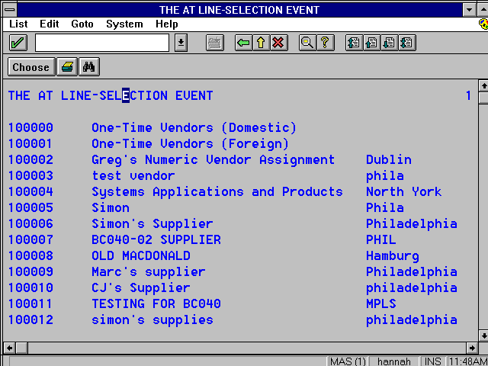
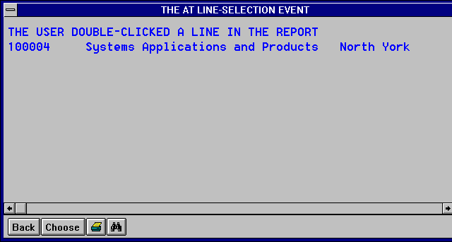
AT LINE-SELECTION and SY-LISEL
Your code should react as shown above.
If you double-click on the drill down window, will another drill down
window appear?
ANSWER:
  No. In the AT LINE-SELECTION event, we CHECK SY-LSIND = 1.
First double-click on a record.
Then a second “drill down” list is created showing data relevant to the record you had initially selected.
If you double-click here, will another drill window appear? Why or why not?

Slide 172
Limitations of the SY-LISEL
System Field
By using SY-LISEL, we now know on which record the user is requesting additional information.
However, remember that one of our challenges was to send information from the selected record back to a SELECT statement to get the vendor’s invoices from the BSIK table.
  Unfortunately, SY-LISEL literally contains a string that duplicates the selected line, which is virtually useless to a SELECT statement. How do you pass …
  “VEND012 QUALITY FABRICATION Homestead”
  … to a SELECT statement? The answer is... you can’t.
Therefore, SY-LISEL will not be very useful to us in this situation.
What we really want is just part of that SY-LISEL string, and we would rather not deal with dissecting strings to get it.
We can’t send an entire string to an ABAP SELECT statement.
The contents of SY-LISEL:
“VEND012 QUALITY FABRICATION HOMESTEAD”
However, if we could somehow send only
individual fields from the selected record, we
would then process that data with an ABAP
SELECT statement.
VEND012
VEND012
SELECT * FROM BSIK WHERE LIFNR =

Slide 173
The HIDE ABAP Reserved Word
The “HIDE” statement is critical to interactive reporting. It facilitates our ability to use only specific fields from the user’s selected line.
Simply put, the code above makes the LFA1-LIFNR field of the selected record available to the programmer.
A HIDE memory area exists for each list in an interactive report - even if an explicit HIDE statement is not coded for that list. The HIDE memory area becomes populated with data when the system encounters the HIDE statement followed by program fields
A New
ABAP
Reserved
Word
Extracting Individual Fields from the Record Chosen by the User
CHECK
START-OF-SELECTION.
SELECT * FROM LFA1.
WRITE: / LFA1-LIFNR, LFA1-NAME1, LFA1-ORT01.
HIDE: LFA1-LIFNR.
ENDSELECT.
SELECT *
SY-SUBRC
SYNTAX: HIDE <program field>.

Slide 174


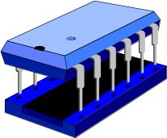
The HIDE Memory Area
The HIDE statement is, in some ways, very similar to the WRITE statement.
  The “WRITE” statement writes data from the program work area to the list.
  The “HIDE” statement writes data from the program work area to a special area in memory. We will call this area in memory the “HIDE memory area”.
CHECK
SELECT *
START-OF-SELECTION.
SELECT * FROM LFA1.
WRITE: / LFA1-LIFNR, LFA1-NAME1, LFA1-ORT01.
HIDE: LFA1-LIFNR.
ENDSELECT.
SY-SUBRC
LIST
MEMORY
WRITE: /
RECORD # 2
HIDE
LFA1 WORK AREA

Slide 175
The HIDE Memory Area (Showing the Index)
The index numbers in the HIDE memory area correspond to the line numbers on the report.
  That’s why index 1 and 2 of the HIDE memory contain no values. Line numbers 1 and 2 of your report correspond to the default header lines.
    Header line number 1 in your report contains the program title, page number, and date. Header line number 2 is the underline.
    Because you did not HIDE values for these two header lines, no values exist in the HIDE memory area for LFA1-LIFNR at index 1 and 2.
    Note: The ‘----’ in the HIDE memory area above indicates that no value was “hidden” for LFA1-LIFNR at the corresponding index number.
Remember: When the system encounters a HIDE statement, it asks itself, “What line have I just written to the report? What is that report line number?” The system “hides” the specified value at the corresponding index number in the HIDE memory area.
Shortly, we will learn how a programmer can access any of the data in the HIDE memory area via its index.
START-OF-SELECTION.
SELECT * FROM LFA1.
WRITE: / LFA1-LIFNR, . . .
HIDE: LFA1-LIFNR.
ENDSELECT.
SELECT *
MEMORY
INDEX
1
2
3
4
5
LFA1-LIFNR
----
----
VEND011
VEND012
VEND013
CHECK
SY-SUBRC
This is what the HIDE memory area and LFA1 work area look like after the SELECT statement above has finished processing.
RECORD # 3
LFA1 WORK AREA

Slide 176
The HIDE Memory Area(with More than One Field Stored)
The HIDE command is not limited to holding the contents of just one field’s data. As shown above, the HIDE command is capable of placing as many fields as you would like into the HIDE memory area.
You can also “hide” data variables as well (not just fields from the table work area created with the TABLES statement).
  For example: TABLES: LFA1.
  DATA: VAR1(25).
  . . .
  WRITE: / LFA1-LIFNR, LFA1-NAME1, LFA1-ORT01.
  HIDE: LFA1-LIFNR, LFA1-TELF1, VAR1.
  . . .
  Notice in this example that you can “hide” values that are not written to the list with the “WRITE” statement (e.g. LFA1-TELF1 and VAR1).
Note: The ‘----’ in the HIDE memory area above indicates that no values were “hidden” for LFA1-LIFNR or LFA1-TELF1 at the corresponding index number.
START-OF-SELECTION.
SELECT * FROM LFA1.
WRITE: / LFA1-LIFNR, LFA1-NAME1, LFA1-ORT01.
HIDE: LFA1-LIFNR, LFA1-TELF1.
ENDSELECT.
SELECT *
HIDE MEMORY
INDEX
1
2
3
4
5
LFA1-LIFNR
----
----
VEND011
VEND012
VEND013
LFA1-TELF1
----
----
555-1111
555-2222
555-3333
CHECK
SY-SUBRC
If we used the HIDE statement to hide both LIFNR and TELF1, our HIDE memory area would look like this.

Slide 177
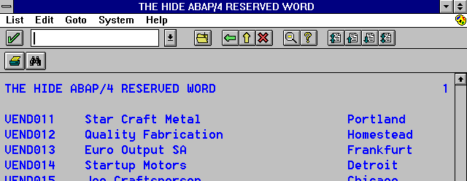
The HIDE Index Numbers
When the user selects a line and triggers a user event (e.g. double-clicking on a line triggers AT LINE-SELECTION), that line’s number is used to fetch the LFA1-LIFNR value with the matching index from memory.
  So if the user were to select the fourth line on the report, the LFA1-LIFNR value “hidden” at index number of four would become available (via the work area) for the programmer to use.
  If the programmer had “hidden” additional fields, such as LFA1-NAME1 and LFA1-ORT01, these values would also become available based on the line number selected.
We will expand on this concept shortly… but first, let’s enhance our current program to include the HIDE functionality.
The Correlation between the HIDE Memory Area and Line Numbers
INDEX
1
2
3
4
LINE 4 from the screen corresponds
with INDEX 4 from the HIDE memory area.
MEMORY
INDEX
1
2
3
4
5
LFA1-LIFNR
----
----
VEND011
VEND012
VEND013
VEND012
LFA1 WORK AREA

Slide 178
Coding Example Using the HIDE ABAP Reserved Word
We will enhance the Y190XX02 program to include HIDE memory functionality.
1.“Hide” every value from the LFA1-LIFNR field and the LFA1-TELF1 field in the HIDE memory area by entering the HIDE statement shown above.
  We will not make use of the LFA1-TELF1 “hidden” value, but we want to illustrate that more than one value can be “hidden” for each line of the report.
REPORT Y190XX02.
TABLES: LFA1, BSIK.
START-OF-SELECTION.
SELECT * FROM LFA1.
WRITE: / LFA1-LIFNR, LFA1-NAME1, LFA1-ORT01.
HIDE: LFA1-LIFNR, LFA1-TELF1.
ENDSELECT.
CHECK
SELECT *
SY-SUBRC

Slide 179
What Happens When the System
Hides Values?
The slide above illustrates the processing that occurs when the system produces the basic list from the code on the previous page:
  The “SELECT * FROM LFA1” statement reads LFA1 records, one at a time, into the the table work area.
    The “table work area” is a field string created by the TABLES statement.
  The “WRITE: / LFA1-LIFNR, LFA1-NAME1, LFA1-ORT01” statement writes these three fields from the program work area to the list.
  The “HIDE: LFA1-LIFNR, LFA1-TELF1” statement takes the values in these two fields and “hides” them in the special HIDE memory area.
    These values are “hidden” for a specific index number corresponding to the current line number on the list.
Note: The ‘----’ in the HIDE memory area above indicates that no values were “hidden” for LFA1-LIFNR or LFA1-TELF1 at the corresponding index number.
DATA
SOURCE
TABLE
WORK AREA
BASIC LIST
1 (header)
2 (uline)
3 VEND011 Star Craft Metal
4 VEND012 Quality Fabr.
5 VEND013 Euro Output SA
field string
WRITE
SELECT
HIDE MEMORY
INDEX
1
2
3
4
5
LFA1-LIFNR
----
----
VEND011
VEND012
VEND013
LFA1-TELF1
----
----
555-1111
555-2222
555-3333
HIDE

Slide 180
What Happens When the User Selects a Valid Line?
Now we will learn how to manipulate data stored in the HIDE memory area.
When it encountered a HIDE statement for the basic list, the system previously stored LFA1-LIFNR and LFA1-TELF1 values in the HIDE memory area for the corresponding lines on the basic list.
When the user selects a line and triggers a user event (e.g. double-clicking on a line triggers AT LINE-SELECTION), the system marks down the number of the report line selected.
Using this line number, the system looks to see if any values were “hidden” for that index number.
  If values were “hidden” for that index number, the system places these “hidden” values into the corresponding program fields.
    In our example, the LFA1-LIFNR and LFA1-TELF1 program fields will be restored from the HIDE memory area.
    Since only two fields were hidden, the other fields in the the LFA1 table work area will still contain old data if not cleared out specifically in code, because they are not overwritten by anything in the hide memory area.
  If no values were “hidden” for that index number, nothing happens with the HIDE memory area or program fields.
    The ‘----’ in HIDE above indicates that no values were “hidden” for LFA1-LIFNR or LFA1-TELF1 at the corresponding index number.
BASIC LIST
HIDE MEMORY
1 (header)
2 (uline)
3 VEND011 Star Craft Metal
4 VEND012 Quality Fabr.
5 VEND013 Euro Output SA
INDEX
1
2
3
4
5
LFA1-LIFNR
----
----
VEND011
VEND012
VEND013
LFA1-TELF1
----
----
555-1111
555-2222
555-3333
TABLE WORK AREA
(Field String)
data available for further processing
VEND
011
555-
1111
Old
Data
Old
Data
Old
Data
Old
Data
Old
Data
Old
Data
Old
Data
Old
Data
Old
Data

Slide 181
Coding Example Using the HIDE Memory Area
2. Change the AT LINE-SELECTION event so that it includes the SELECT statement shown above.
  This SELECT statement will retrieve the invoices (from BSIK) for the selected vendor and display these invoices in a detail window.
  Please note that the line WRITE : / ‘THE USER DOUBLE-CLICKED A LINE IN THE REPORT’, as well as WRITE : / SY-LISEL have been removed. These statements are no longer necessary for
  this lesson.
3. Generate your code.
For the “SELECT * FROM BSIK WHERE LIFNR = LFA1-LIFNR” statement to work properly, the vendor number associated with the selected line on the basic list must be in the LFA1-LIFNR program field. The question is: “How will we get this vendor number value from the HIDE memory area?”. To answer this question, you must understand the following points about the HIDE memory area:
  You cannot directly access the values in the HIDE memory area (i.e. there is no ABAP statement that you can use that will retrieve this information).
  The system maintains the HIDE memory area and makes these values available to your program depending on the selected line.
Remember... This is referencing the program field! The value of this field is dependent upon which line you double-clicked in the on-screen report.
AT LINE-SELECTION.
CHECK SY-LSIND = 1.
WINDOW STARTING AT 10 4
ENDING AT 77 12.
SELECT * FROM BSIK WHERE LIFNR = LFA1-LIFNR.
WRITE: / LFA1-LIFNR, BSIK-BELNR.
ENDSELECT.
IF SY-SUBRC <> 0.
WRITE: / ‘No invoices for vendor’, LFA1-LIFNR.
ENDIF.
SELECT *
?
LFA1 WORK AREA

Slide 182
Challenges Revisited
You now know how to provide more detailed information to the user through the use of the AT LINE-SELECTION, and HIDE ABAP reserved words.
At the beginning of this chapter you where presented with two challenges.
  How did the ABAP code “know” which record the user has double-clicked?
  How is this record sent back as criteria to an ABAP SELECT statement?
Both challenges have been answered.
  The ABAP code “knows” which record the user has selected because the system automatically “marks down” the line number. Various system fields are updated based on this line number. For example:
    SY-LISEL contains the contents of the line selected.
    SY-LILLI contains the number of the line selected.
  The system uses that line number to fetch the matching index number from the HIDE memory area. The “hidden” values at that index number are placed in the corresponding program fields. These fields can then be used in the program as criteria in a SELECT statement.
Our work with the HIDE memory area is not yet complete ...
First Challenge:
How did the ABAP code “know” which record the user has selected?
METHOD: When a user event is triggered, the system automatically records the line selected (via SY-LISEL and other system fields).
Second Challenge:
How is this record sent back as criteria to an ABAP SELECT statement?
METHOD: HIDE memory area.

Slide 183
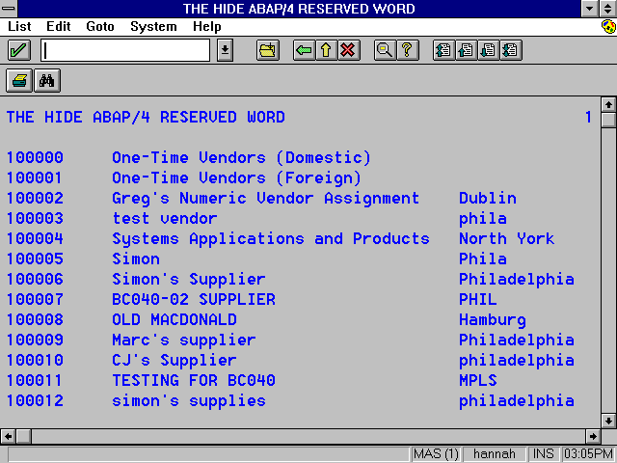
Is the User Selecting a Valid Line in the Report?
1. Restart your program and then double-click on the header.
What happens and why?
2. Restart your program and then double-click on any valid record. Then use the back button to return to the original screen. Now double-click on the header.
What happens and why?
We need to distinguish between a valid and an invalid line:
  A valid line on the report is one that has a “hidden” value needed for
  further processing.
  An invalid line on the report is one that does not have a “hidden” value needed for further processing (e.g. default header lines).
Restart the program and double-click on the header.

Slide 184
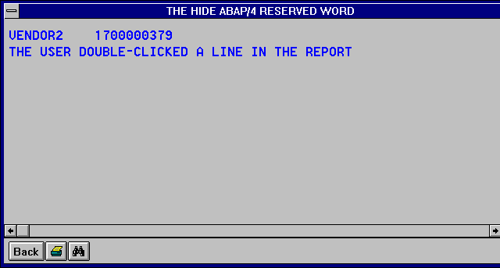
Is the User Selecting a Valid Line in the Report?
Let’s restart the program and then double-click on the header.
What happens? … (see next page)
Restart the program and double-click on the header. What happens?
Where does this data come from?

Slide 185
What Happens When the User Clicks on an Invalid Line First?
Here’s what happens:
  When we double-click on line 1 of the report (the default header), the HIDE memory area with an index of 1 is accessed.
  At index 1, no values were “hidden” for LFA1-LIFNR or LFA1-TELF1.
    For this reason, we would call this an “invalid” line.
  Because no values were “hidden” at the selected line number, the program fields are not updated with any values from the HIDE
  memory area.
  The program fields may contain old data.
    In this example, the LFA1 table work area contains the information from the last vendor selected with the SELECT statement (VENDOR2). During the final loop of the SELECT statement, that vendor’s data was put in the LFA1 table work area.
  The AT LINE-SELECTION event uses the LFA1-LIFNR program field to select vendor invoices, so a detail window is produced with the invoices for the last vendor selected.
  We do not want a detail window produced in this case. Therefore, we will need a way to clear out old data from the program fields. See the next two pages for the solution.
Note: The ‘----’ in the HIDE memory area above indicates that no values were “hidden” for LFA1-LIFNR or LFA1-TELF1 at the corresponding index number.
BASIC LIST
1 (header)
2 (uline)
3 VEND011 Star Craft Metal
4 VEND012 Quality Fabr.
5 VEND013 Euro Output SA
HIDE MEMORY
INDEX
1
2
3
4
5
LFA1-LIFNR
----
----
VEND011
VEND012
VEND013
LFA1-TELF1
----
----
555-1111
555-2222
555-3333
No values are restored from HIDE into program fields.
The last record selected by the “SELECT” statement is still in work area and still available for further processing.
VEND-
OR2
555-
9898
Bacon
Inc.
123
Main
Mr.
Jones
NET
30
Phila.
PA
USA
19103
$100

Slide 186

The END-OF-SELECTION Event
Remember: The END-OF-SELECTION event is the last system event to occur (after all GET and GET LATE events). That is, this event occurs just before the basic list is displayed.
You can use the END-OF-SELECTION event to clear out or “initialise”
program fields.
After all of the other system events have been executed . . .
. . . before the basic list is displayed.
INITIALIZATION.
AT SELECTION-SCREEN.
START-OF-SELECTION.
GET <table>.
GET <table> LATE.
. . . the END-OF-SELECTION event occurs . . .
A New
ABAP
Event
SYNTAX: END-OF-SELECTION.

Slide 187
Handling Invalid Line Selection
Part I - Initialising Fields before Basic List Displayed
The solution to the problem of the user executing the program and immediately selecting an invalid line is two-fold:
  First, the “hidden” field needed for further processing in the user event must be initialised with the “CLEAR” statement just before the basic list is displayed. This ensures that the field will not contain an old value.
  (See #1 above)
    The END-OF-SELECTION event is necessary if the basic list is produced using GET/GET LATE events (because it is the only event that occurs after all GET events and before the basic list is displayed).
  Second, make sure that the “hidden” field is not initial before continuing with the main processing of the user event. This check can be handled with the “CHECK NOT <program field> IS INITIAL” statement. This statement is saying: “check that the <program field> is not initial”. In our example, this <program field> is LFA1-LIFNR. (See #2 above)
    If the CHECK is true (the <program field> is not initial), that means the user selected a valid line and the value in the HIDE memory area was placed into the <program field>. In this case, processing will continue in the user event and the detail window will be displayed.
    If the CHECK is false (the <program field> is initial), that means the user selected an invalid line and no value was restored from the HIDE memory area; therefore, the <program field> is still initial from the “CLEAR” statement. In this case, processing of the user event will end and no detail window will be displayed.
1
END-OF-SELECTION.
CLEAR LFA1-LIFNR.
AT LINE-SELECTION.
CHECK SY-LSIND = 1.
CHECK NOT LFA1-LIFNR IS INITIAL.
WINDOW STARTING AT 10 4
ENDING AT 77 12.
SELECT * FROM BSIK WHERE LIFNR = LFA1-LIFNR.
WRITE: / LFA1-LIFNR, BSIK-BELNR.
ENDSELECT.
IF SY-SUBRC <> 0.
WRITE: / ‘No invoices for vendor’, LFA1-LIFNR.
ENDIF.
First: Initialise the LFA1-LIFNR program field just before the basic list is displayed.
Second: Make sure the LFA1-LIFNR program field is not initial before processing the rest of the user event (i.e. make sure the user selected a valid line).
2
SELECT *

Slide 188
Click on a Valid Line First …
Okay… we’ve solved the first problem. However, we still have a problem if we initially select a valid line to produce a detail window and then return to the basic list and select an invalid line. In this case, no detail window should be displayed, but it is.
Here’s what happens:
  When we double-click on a valid line of the report (one with a vendor record), the HIDE memory area with that index number is accessed.
  At that index, values were “hidden” for LFA1-LIFNR and LFA1-TELF1.
    For this reason, we would call it a “valid” line.
  Because values were “hidden” at the selected line number, the program fields are updated with the values from the HIDE memory area.
    Specifically, the LFA1-LIFNR and LFA1-TELF1 program fields are restored from the HIDE memory area (with VEND012 and 555-2222)
  The AT LINE-SELECTION event uses the LFA1-LIFNR program field to select vendor invoices, so a detail window is produced with the invoices for the selected vendor (VEND012).
  Now, when we return to the basic list, the LFA1-LIFNR program field still contains the vendor number selected (VEND012).
  See next page for further explanation of what happens.
Note: The ‘----’ in the HIDE memory area above indicates that no values were “hidden” for LFA1-LIFNR or LFA1-TELF1 at the corresponding index number.
BASIC LIST
1 (header)
2 (uline)
3 VEND011 Star Craft Metal
4 VEND012 Quality Fabr.
5 VEND013 Euro Output SA
HIDE MEMORY
INDEX
1
2
3
4
5
LFA1-LIFNR
----
----
VEND011
VEND012
VEND013
LFA1-TELF1
----
----
555-1111
555-2222
555-3333
TABLE WORK AREA
(Field String)
data available for further processing
VEND
012
555-
2222
Old
Data
Old
Data
Old
Data
Old
Data
Old
Data
Old
Data
Old
Data
Old
Data
Old
Data

Slide 189
… Then Click on an Invalid Line
Here’s what happens (Continued)?
  When we return to the basic list and double-click on an invalid line (e.g. the default header), the HIDE memory area with that index number is accessed.
  At that index, no values were “hidden” for LFA1-LIFNR or LFA1-TELF1.
    For this reason, we call it an “invalid” line.
  Because no values were “hidden” at the selected line number, the program fields are not updated with any values from the HIDE memory area.
  The program fields will contain the data from the previous valid line selected.
    In this example, the LFA1-LIFNR and LFA1-TELF1 program fields still contain the information from the previous valid line selected (VEND012 and 555-2222).
  The AT LINE-SELECTION event uses the LFA1-LIFNR program field to select vendor invoices, so a detail window is produced with the invoices for the previous valid line selected (VEND012).
  We do not want a detail window produced in this case. See the next page for the solution.
Note: The ‘----’ in the HIDE memory area above indicates that no values were “hidden” for LFA1-LIFNR or LFA1-TELF1 at the corresponding index number.
BASIC LIST
1 (header)
2 (uline)
3 VEND011 Star Craft Metal
4 VEND012 Quality Fabr.
5 VEND013 Euro Output SA
HIDE MEMORY
INDEX
1
2
3
4
5
LFA1-LIFNR
----
----
VEND011
VEND012
VEND013
LFA1-TELF1
----
----
555-1111
555-2222
555-3333
TABLE WORK AREA
(Field String)
No values restored from HIDE into program fields. Values restored from last valid line selected by the user are still in the work area.
VEND
012
555-
2222
Old
Data
Old
Data
Old
Data
Old
Data
Old
Data
Old
Data
Old
Data
Old
Data
Old
Data

Slide 190
Handling Invalid Line Selection
Part II - Initialising Fields after Each Use
The solution to the problem of the user selecting a valid line, returning to the basic list, and then selecting an invalid line is two-fold:
  First, the “hidden” field needed for further processing in the user event must be initialised with the “CLEAR” statement just before the detail list is displayed. This ensures that the field will not contain an old value when the user returns to the previous list. (See #1 above)
    The “CLEAR” statement should be at the end of the user event.
  Second, make sure that the “hidden” field is not initial before continuing with the main processing of the user event. This check can be handled with the “CHECK NOT <program field> IS INITIAL” statement. This statement is saying: “check that the <program field> is not initial”. In our example, this <program field> is LFA1-LIFNR. (See #2 above)
    If the CHECK is true (the <program field> is not initial), that means the user selected a valid line and the value in the HIDE memory area was placed into the <program field>. In this case, processing will continue in the user event and the detail window will be displayed.
    If the CHECK is false (the <program field> is initial), that means the user selected an invalid line and no value was restored from the HIDE memory area; therefore, the <program field> is still initial from the “CLEAR” statement. In this case, processing of the user event will end and no detail window will be displayed.
We have now solved both problems encountered when selecting an invalid line.
END-OF-SELECTION.
CLEAR LFA1-LIFNR.
AT LINE-SELECTION.
CHECK SY-LSIND = 1.
CHECK NOT LFA1-LIFNR IS INITIAL.
WINDOW STARTING AT 10 4
ENDING AT 77 12.
SELECT * FROM BSIK WHERE LIFNR = LFA1-LIFNR.
WRITE: / LFA1-LIFNR, BSIK-BELNR.
ENDSELECT.
IF SY-SUBRC <> 0.
WRITE: / ‘No invoices for vendor’, LFA1-LIFNR.
ENDIF.
CLEAR LFA1-LIFNR.
First: Initialise the LFA1-LIFNR program field just before the detail list is displayed.
Second: Make sure the LFA1-LIFNR program field is not initial before processing the rest of the user event (i.e. make sure the user selected a valid line).
2
SELECT *
1

Slide 191
Flow of Data
In the above slide, solid lines with arrows represent the flow of data from the SELECT, WRITE, and HIDE statements:
  SELECT: Selects a record from the database table and places it into the table work area
  WRITE: Writes data from the work area to the screen
  HIDE: Writes data from the work area to the hide memory area, with an index number matching the report line number
  ENDSELECT: Completes the loop. The next record from the database table is processed similarly, as are all others until the last record has been read.
In the above slide, broken lines with arrows represent the flow of data when the user selects a line on the screen and triggers a user event (i.e., triggers AT LINE-SELECTION, AT USER-COMMAND, or AT PF##):
  The system marks down the number of the report line selected. Using this line number, the system looks to see if any values were “hidden” for that index number.
    If values were “hidden” for that index number, the system places these “hidden” values into the corresponding program fields.
    If no values were “hidden” for that index number, nothing happens with the HIDE memory area or program fields.
HIDE
MEMORY
BASIC
LIST
DATA
SOURCE
WORK AREA

Slide 192
Providing Additional Information on a Single Record Only
Up until this point, the users of your interactive reports are able to request additional information that pertains to one record only.
Perhaps your users would benefit from the ability to select more than a single record. Then, through the use of drill down windows, generate additional information that pertains to all of the selected records.
The next page includes an example.
First the user double-clicks on a single record.
Then a “drill down” list is created which shows data that is relevant only to the single record selected by the user.

Slide 193
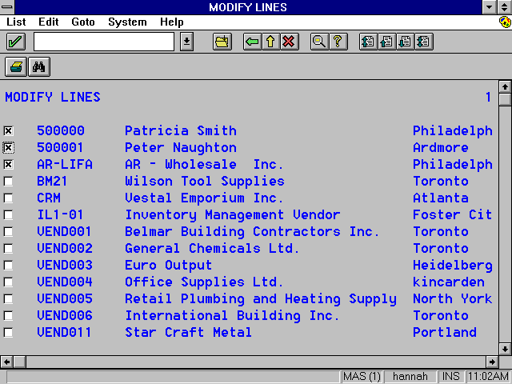
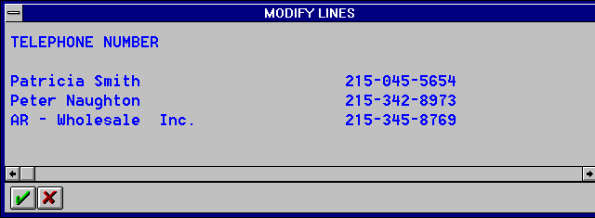
Providing Additional Information on Multiple Records
In the example shown above the user is first presented with a list of vendors.
This list is designed with checkboxes that the user can simply “check” by clicking on them.
Each vendor that was selected in the initial screen is then displayed in a drill down window along with their corresponding telephone number.
First, the user clicks inside of the checkboxes for the vendors that the user is interested in.
Then a drill down window
appears that contains the
telephone numbers for each of the previously selected vendors.

Slide 194
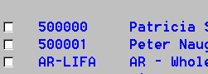
Challenges
In this chapter we will learn how to “draw” checkboxes to the screen, then subsequently loop through each of the lines in the report to determine whether or not they were checked.
Additionally we will learn how to modify lines that were already written to the screen. This will give us the ability to write changes to any line in the report we wish. We can even change the formatting of a particular line(s).
First we must learn techniques to
“draw” checkboxes on the screen.
Then we must learn techniques to loop through each of the lines on the
report and determine whether or not they were checked.
READ LINE 1.. checked? YES or NO
READ LINE 2.. checked? YES or NO
READ LINE 3 .. checked? YES or NO
READ LINE n .. checked? YES or NO

Slide 195
Coding Example
Writing Checkboxes to the Screen
1. Create a new program and call it Y190XX03 (where XX are the last two digits from your SAP logon ID).
2. Write the code you see above.
3. Generate and execute your code.
  To create a checkbox on a report, you need to perform the following steps:
    Create a single-character variable.
      In the code above, the DATA statement creates a single character type variable called CHK1.
    Use the “AS CHECKBOX” addition to the WRITE statement to write the single-character field to the report as a checkbox.
These checkboxes will be useless, however, unless we have the ability to programmatically read the lines in the report to determine whether or not they have been checked.
NOTE: The REPORT statement uses the LINE-SIZE option to increase the number of columns in the report.
  The maximum line size is 255.
REPORT Y190XX03 LINE-SIZE 255.
TABLES: LFA1.
DATA: CHK1.
START-OF-SELECTION.
SELECT * FROM LFA1 WHERE TELF1 <> SPACE.
WRITE: / CHK1 AS CHECKBOX,
LFA1-LIFNR, LFA1-NAME1, LFA1-ORT01.
SKIP.
ENDSELECT.
Create a single-character variable.
SELECT *
Then WRITE it to the
report as a checkbox.
CHECK
SY-SUBRC

Slide 196
The READ LINE Statement
The READ LINE ABAP reserved word is capable of reading the contents of the specified line number into the SY-LISEL system field. For example if you were to write and execute the following code:
  READ LINE 1.
  The contents of line 1 would now be contained inside the SY-LISEL
  system field.
The READ LINE ABAP reserved word also has an addition called FIELD VALUE <F> INTO <V>. Using this addition, an ABAP programmer can copy data from a particular on-screen field <F> and place it into a data variable <V>. For example if you were to write and execute the following code:
  READ LINE 11 FIELD VALUE LFA1-LIFNR INTO VAR1.
  After this code executes, the contents of the data variable VAR1 would be equal to the LFA1-LIFNR field value from line 11 of your on-screen report. You could then check the data variable VAR1 for its value with CASE or IF logic.
The INTO part of the FIELD VALUE addition is only necessary if you want to put the value of the on-screen field into a different field.
  For example, if you want to put the value of the on-screen field LFA1-LIFNR into the program field LFA1-LIFNR, the READ LINE statement would be:
  READ LINE 11 FIELD VALUE LFA1-LIFNR
Programmatically Reading a Line in a Report
MEMORY
VAR1 = VEND003
READ LINE 11 FIELD VALUE LFA1-LIFNR INTO VAR1.
A New
ABAP
Reserved Word
SYNTAX: READ LINE <#>.

Slide 197
The SY-INDEX System Field
The following line of code. . .
  READ LINE 11 FIELD VALUE <report field> INTO <program field>.
  . . .will read line 11 and then copy data from the <report field> on line 11 and place that data into the <program field>.
  This functionality will not fit our needs exactly. Remember we need to loop through each of the lines on the report, not just line 11.
When placed inside a DO loop, the ABAP system field SY-INDEX starts at one when the loop is entered and increments with each pass of the LOOP.
Therefore, if we utilise a DO loop and the SY-INDEX system field, we can loop through each of the lines in the report with the following code:
  READ LINE SY-INDEX FIELD VALUE <report field> INTO <program field>.
Remember to check SY-SUBRC. If you don’t, you could find yourself in an endless LOOP.
Looping through Each of the Lines in the Report
READ LINE SY-INDEX FIELD VALUE LFA1-LIFNR INTO VAR1.
READ LINE 1
READ LINE 2
READ LINE 3
A New
ABAP
System Field
READ LINE n
SYSTEM FIELD: SY-INDEX

Slide 198
The READ LINE Statement
1. Edit the Y190XX03 program so that the SELECT statement now writes to the
HIDE memory area as well. Type the new code.
REPORT Y190XX03 LINE-SIZE 255.
TABLES: LFA1.
DATA: CHK1.
START-OF-SELECTION.
SELECT * FROM LFA1 WHERE TELF1 <> SPACE.
WRITE: / CHK1 AS CHECKBOX,
LFA1-LIFNR, LFA1-NAME1, LFA1-ORT01.
HIDE: LFA1-NAME1, LFA1-TELF1.
SKIP.
ENDSELECT.
CHECK
SELECT *
SY-SUBRC
Write this code.
This code continues on the next page.

Slide 199
Coding Example
The READ LINE Statement
2. Write the new code that you see above.
3. Generate and execute your code.
  We then use the READ LINE statement in a DO loop to read each line of
  the report.
  The READ LINE SY-INDEX FIELD VALUE CHK1 places the value of the on-screen CHK1 field into the program field CHK1. The following syntax would accomplish the same result: READ LINE SY-INDEX FIELD VALUE CHK1 INTO CHK1.
    If the line on the report does not contain a CHK1 field (i.e., the default header lines), the program field CHK1 is not updated.
      Therefore, we need to CLEAR the field before the READ LINE statement so an old value is not in the field.
  It is important to know that the READ LINE statement triggers the system to restore values from the HIDE memory area for the line number read.
    For this reason, the LFA1-NAME1 and LFA1-TELF1 values are available to display on the detail list for all of the vendors selected.
  We then test SY-SUBRC to make sure that we have not reached the end of the list. If the end of the list has already been reached, SY-SUBRC will not be zero.
  If we have not reached the end of the list, we check the program field CHK1 to make sure that it is an ‘X’ (meaning the user is interested in that record). If it is a ‘X’, we write the name and phone number to the detail list.
AT PF06.
WINDOW STARTING AT 10 4 ENDING AT 77 12.
DO.
CLEAR CHK1.
READ LINE SY-INDEX FIELD VALUE CHK1.
IF SY-SUBRC <> 0.
EXIT.
ELSE.
CHECK CHK1 = ‘X’.
WRITE: / LFA1-NAME1, LFA1-TELF1.
ENDIF.
ENDDO.
READ LINE 1
READ LINE 2
READ LINE 3
READ LINE n
..checked? YES or NO
.. checked? YES or NO
.. checked? YES or NO
.. checked? YES or NO

Slide 200
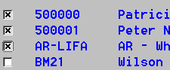
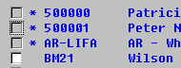
The MODIFY LINE Statement
The ABAP statement MODIFY LINE is very similar to the READ LINE statement. Like READ LINE, MODIFY LINE can use SY-INDEX to LOOP through each of the lines in the report.
With the MODIFY LINE statement, you can modify the value or the format of an on-screen field.
  MODIFY LINE <line> FIELD VALUE <report field> FROM <variable>.
    With this form of the MODIFY LINE statement, the new value for the <report field> will come from the program <variable>. This <variable> can also be a hard-coded literal.
    In the case of the FIELD VALUE addition, you are copying data from a program field and placing it into a report field.
  MODIFY LINE <line> FIELD FORMAT <report field> <format option>.
    With this form of the MODIFY LINE statement, the <on-screen field’s> format is changed based on the specified <format option>.
    The following <format options> are available: (1) colour <n> on/off, (2) intensified on/off, (3) inverse on/off, (4) hotspot on/off, (5) input on/off, and (6) reset.
    For example, the “MODIFY LINE 11 FIELD FORMAT LFA1-LIFNR INTENSIFIED OFF” statement will turn off the bold font attribute on the LFA1-LIFNR field for line number 11.
First the user clicks on the vendors
of interest.
Then the user presses the
F6 key on the keyboard.
When the user has finished reading the
data in the drill down window, he/she
returns to the initial screen to find that
it has been modified to show the records
that have already been selected.

Slide 201
Coding Example
The MODIFY LINE Statement
1. Edit the Y190XX03 program that you have been working on so that it looks like the code shown above.
  We create a single character data variable called WAS_USED that we will write to the screen between the CHK1 checkbox and the LFA1-LIFNR field.
  This WAS_USED variable will be used to indicate that the vendor was already selected by the user.
REPORT Y190XX03 LINE-SIZE 255.
TABLES: LFA1.
DATA: CHK1.
DATA: WAS_USED.
SELECT * FROM LFA1 WHERE TELF1 <> SPACE.
WRITE: / CHK1 AS CHECKBOX, WAS_USED,
LFA1-LIFNR, LFA1-NAME1, LFA1-ORT01.
HIDE: LFA1-NAME1, LFA1-TELF1.
SKIP.
ENDSELECT.
Add new code here and here.
SELECT *
CHECK
SY-SUBRC

Slide 202
Coding Example
The MODIFY LINE Statement
2. Add the new code shown above.
  MODIFY CURRENT LINE modifies the line that was last read by the READ LINE statement.
    This alleviates the need on your part to manage another LOOP.
  The WAS_USED on-screen field is updated with an asterisk (*).
  The CHK1 on-screen field’s format is changed so that it can no longer be selected by the user. INPUT OFF is a formatting option.
  The CHK1 on-screen field is also updated with a space so that it is no
  longer checked.
AT PF06.
WINDOW STARTING AT 10 4 ENDING AT 77 12.
DO.
CLEAR CHK1.
READ LINE SY-INDEX FIELD VALUE CHK1.
IF SY-SUBRC <> 0.
EXIT.
ELSE.
CHECK CHK1 = ‘X’.
MODIFY CURRENT LINE:
FIELD VALUE WAS_USED FROM ‘*’
CHK1 FROM SPACE
FIELD FORMAT CHK1 INPUT OFF.
WRITE: / LFA1-NAME1, LFA1-TELF1.
ENDIF.
ENDDO.
Add new code here.

Slide 203
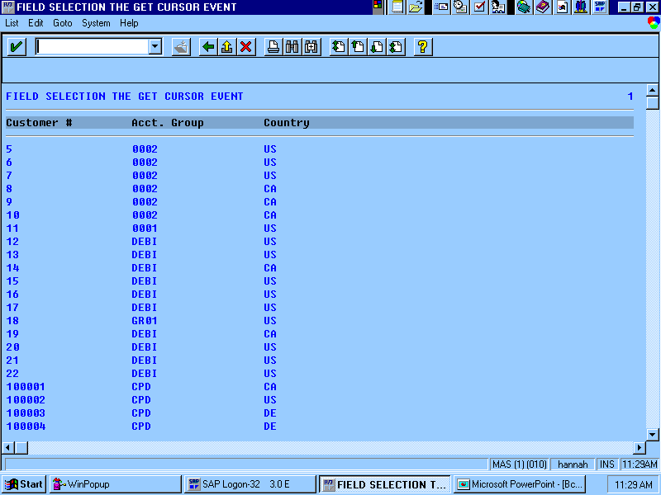
GET CURSOR FIELD
Determining Which Field the User Selected
The GET CURSOR FIELD <V1> ABAP statement is used to return to a program variable <V1> the name of the field that the user selected on the report.
  As shown in the above example, if the user selects a record in the KNA1-KTOKD field, the data variable VAR1 is updated with “KNA1-KTOKD”.
There also exists the GET CURSOR VALUE <V2> ABAP statement. GET CURSOR VALUE <V2> returns to a data variable <V2> the value that the
user selected.
  For example, if the user selected customer number 5’s account group field (KNA1-KTOKD) the data variable VAR1 is updated with “0002”.
These two options can be combined to retrieve both the field name and field value with the following statement:
  GET CURSOR FIELD <V1> VALUE <V2>.
The next page contains a code example of the GET CURSOR statement.
MEMORY
VAR1 = KNA1-KTOKD
GET CURSOR FIELD returns to a program variable the name of the field selected by the user.
A NEW
ABAP
Reserved Word
SYNTAX: GET CURSOR FIELD <V1>.

Slide 204
Coding Example
The GET CURSOR FIELD Statement
We will create a very simple program that uses a CASE statement to check the returned values from the GET CURSOR statement.
The data statement contains the data variables that will be populated by the GET CURSOR statement. FLDNAME stands for field name and FLDVAL stands for field value.
1. Create a new program and call it Y190XX04 (where XX are the last two digits from your SAP logon ID).
2. Write the code that you see above.
REPORT Y190XX04 LINE SIZE 255.
TABLES: KNA1.
DATA: FLDNAME(30), FLDVAL(50).
START-OF-SELECTION.
SELECT * FROM KNA1.
WRITE: / KNA1-KUNNR, 20 KNA1-KTOKD, 40 KNA1-LAND1.
ENDSELECT.
CHECK
SELECT *
SY-SUBRC
This code example is continued on the next page.

Slide 205
Coding Example
The GET CURSOR FIELD Statement
3. Write the code that you see below.
  When the user double-clicks a line, the AT LINE-SELECTION event executes, and a drill down window is created.
  Depending upon which field the user actually selected, the FLDNAME program field will then get updated with the name of the field (“KNA1-KUNNR” for example).
  Depending on which field the user actually selected, the FLDVAL program field will get updated with value that is contained within the on-screen field selected (“5” for example).
  We will now execute a CASE on FLDNAME. Depending on the contents of the FLDNAME data variable, we will write to the screen some various statements. Included in those statements will be the FLDVAL data variable.
4. Generate and execute your code.
  In addition to the GET CURSOR statement, there also exists a
  SET CURSOR FIELD <on-screen field> LINE <#> and SET CURSOR <column> <line> statement.
    With both of the SET CURSOR commands, you can position the cursor on the screen, either in an input field or at particular co-ordinates on the screen.
    SET CURSOR can first be used to position the cursor, and then GET CURSOR can be used as we have seen previously.
AT LINE-SELECTION.
WINDOW STARTING AT 10 4 ENDING AT 77 12.
GET CURSOR FIELD FLDNAME VALUE FLDVAL.
CASE FLDNAME.
WHEN ‘KNA1-KUNNR’.
WRITE: / ‘You selected the customer NUMBER field’,
/ ‘Specifically you chose customer’, FLDVAL.
WHEN ‘KNA1-KTOKD’.
WRITE: / ‘You selected the customer ACCT GROUP field’,
/ ‘Specifically you chose acct group’, FLDVAL.
WHEN ‘KNA1-LAND1’.
WRITE: / ‘You selected the COUNTRY field’,
/ ‘Specifically you chose country’, FLDVAL.
ENDCASE.

Slide 206

Other System Fields
When a list is generated:
  SY-COLNO - Current column number
  SY-LINCT - Number of lines from the REPORT stmt
  SY-LINNO - Current line number
  SY-LINSZ - Line width from the REPORT stmt
  SY-PAGCT - Maximum number of pages from the REPORT stmt
  SY-PAGNO - Current page number
  SY-SCOLS - Number of columns in the window
  SY-SROWS - Number of lines in the window
  SY-TITLE - Report title taken over from the text elements or attributes
During interactive reporting:
  SY-CPAGE - Number of current page
  SY-CUCOL - Cursor position (column)
  SY-CUROW - Cursor position (line)
  SY-LILLI - Number of the selected list line
  SY-LISEL - Content of the selected list line
  SY-LISTI - Index of the selected list line
  SY-LSIND - Index of the displayed list level
  SY-PFKEY - Current GUI status
  SY-STACO - List displayed from column
  SY-STARO - List displayed from line
  SY-UCOMM - Function code invoked by user
SY-TITLE
SY-PAGCT
SY-CUROW
SY-LSIND
SY-LILLI
When do system fields get filled?

Slide 207
Calling Programs

Slide 208
Calling Programs
Apart From Modularization by External/Internal Subroutines,
Or by calling function modules , one program can call another
Executable program or Dialog modules .
Type 1 Program
Transaction
Call (without returning)
SUBMIT
LEAVE TO TRANSACTION
Call and return
SUBMIT AND RETURN
CALL TRANSACTION

Slide 209
Calling Programs
The first application program started opens an internal session within the main session. The internal session has a memory area containing ABAP program and its associated data. When the program calls external routines (methods, subroutines or function modules) their main program and working data are also loaded into the memory area of the internal session. If the active application program calls a further application program, the system opens another internal session:-
If the second program does not return control to the calling program when it has finished running, the called program replaces the calling program in the internal session. The contents of the memory of the calling program are deleted.
If the second program does return control to the calling program when it has finished running, the session of the called program is not deleted,but becomes inactive, and its memory contents are placed on a stack.
Passing Data Between Programs
SAP Memory
SAP memory is a memory area to which all main sessions within a SAPgui have access. Can be used either to pass data from one program to another within a session, or to pass data from one session to another. Application programs that use SAP memory must do so using SPA/GPA parameters (also known as SET/GET parameters). These parameters can be set either for a particular user or for a particular program using the SET PARAMETER statement. Other ABAP programs can then retrieve the set parameters using the GET PARAMETER statement. The most frequent use of SPA/GPA parameters is to fill input fields on screens .
ABAP Memory
ABAP memory is a memory area that all ABAP programs within the same internal session can access using the EXPORT and IMPORT statements. Data within this area remains intact during a whole sequence of program calls. To pass data to a program which you are calling, the data needs to be placed in ABAP memory before the call is made. The internal session of the called program then replaces that of the calling program. The program called can then read from the ABAP memory.

Slide 210
Calling Programs
Calling Executable Programs
SUBMIT <rep>|(<field>) [AND RETURN] [<options>].
The name of the report to be called can be specified statically in the program or dynamically . If ON RETURN is used , then the control returns to the calling program on completion of the called program at the point from which the called program was invited, else control returns to the level from which you started the calling program.
Filling the Selection Screen of a Called Program VIA SELECTION-SCREEN
The selection screen of the called executable program (report) appears. If you transfer values to the program using one or more of the other options, the corresponding input fields in the selections screen are filled. The user can change these values. By default, the system does not display a selection screen after SUBMIT.
SUBMIT... [VIA SELECTION-SCREEN]
[USING SELECTION-SET <var>]
[WITH <sel> <criterion>]
[WITH FREE SELECTIONS <freesel>]
[WITH SELECTION-TABLE <rspar>].
VIA SELECTION-SCREEN
The selection screen of the called executable program (report) appears. If you transfer values to the program using one or more of the other options, the corresponding input fields in the selections screen are filled. The user can change these values. By default, the system does not display a selection screen after SUBMIT.
USING SELECTION-SET <var>
This option tells the system to start the called program with the variant <var>.
WITH <sel> <criterion>
Use this option to fill individual elements <sel> of the selection screen (selection tables and parameters). Use one of the elements <criterion>:
<op> <f> [SIGN <s>], for single value selection
If <sel> is a selection criterion, use <op> to fill the OPTION field, <f> to fill the LOW field, and <s> to fill the SIGN field of the selection table <sel> in the called program.
If <sel> is a parameter, you can use any operator for <op>. The parameter <sel> is always filled with <f>.
[NOT] BETWEEN <f 1 > AND <f 2 > [SIGN <s>], for interval selection
IN <seltab>, transferring a selection table
This addition fills the selection table <sel> in the called program with the values of the table <seltab> in the calling program. Table <seltab> must have the structure of a selection table. Use the RANGES statement to create selection tables.

Slide 211
Affecting Lists in Called Programs
Modifying the List Structure
You can modify the list structure of a called program by using the following additions in the SUBMIT statement:
SUBMIT... [LINE-SIZE <width>] [LINE-COUNT <length>].
Printing Lists
You can send a list from a called program directly to the spool system instead of displaying it on the screen. To do this, use the TO SAP-SPOOL addition in the SUBMIT statement:
SUBMIT... TO SAP-SPOOL <print-parameters>.
Saving Lists
Instead of displaying a list on the screen, you can store it in ABAP memory using the EXPORTING LIST TO MEMORY addition in the SUBMIT statement:
SUBMIT... AND RETURN
EXPORTING LIST TO MEMORY.
This statement stores the list in ABAP memory, allowing the calling program to access it once the called program has finished. You must use the AND RETURN addition in this case. You cannot use the additions EXPORTING LIST TO MEMORY and TO SAP-SPOOL together.
The function group SLST provides function modules for accessing the saved list, including for example:
LIST_FROM_MEMORY
WRITE_LIST
DISPLAY_LIST

Slide 212
Program Statements to Leave a Called Program
Usually, the user exits a program called using SUBMIT ... AND RETURN by choosing F3 or F15 from list level 0 of the called report.
To execute further statements before returning to the called program (for example, to place data in ABAP memory using the EXPORT statement), you need to modify the user interface of the called program. For example, you can define your own function code for the Back function and process it in the AT USER-COMMAND event. After you have written your additional statements, you can leave the called program using the LEAVE statement.
REPORT REP1 NO STANDARD PAGE HEADING.
DATA: ITAB TYPE I OCCURS 10,
NUM TYPE I.
SUBMIT REP2 AND RETURN.
IMPORT ITAB FROM MEMORY ID 'HK'.
LOOP AT ITAB INTO NUM.
WRITE / NUM.
ENDLOOP.
REPORT REP2 NO STANDARD PAGE HEADING.
DATA: NUMBER TYPE I,
ITAB TYPE I OCCURS 10.
SET PF-STATUS 'MYBACK'.
DO 5 TIMES.
NUMBER = SY-INDEX.
APPEND NUMBER TO ITAB.
ENDDO.
TOP-OF-PAGE.
WRITE 'Report 2'.
ULINE.
AT USER-COMMAND.
CASE SY-UCOMM.
WHEN 'MBCK'.
EXPORT ITAB TO MEMORY ID 'HK'.
LEAVE.
ENDCASE.

Slide 213
Calling Transactions
If you do not want to return to the calling program at the end of the new transaction:-
LEAVE TO TRANSACTION <tcod> [AND SKIP FIRST SCREEN].
If, on the other hand, you do not want to return to the calling program at the end of the new transaction, use the statement:
CALL TRANSACTION <tcod> [AND SKIP FIRST SCREEN] [USING <itab>].
If the first screen calls itself as the next screen, you cannot skip it. The USING ITAB addition in the CALL TRANSACTION statement allows you to pass an internal table <itab> to the new transaction. <itab> has the form of a batch input table.

Slide 214
Using SPA/GPA Parameters
SPA/GPA parameters are values that the system stores in the global, user-specific SAP memory which allows to pass values between programs. A user can access the values stored in the SAP memory during one terminal session for all parallel sessions. Each SPA/GPA parameter is identified by a 20-character code. You can maintain them in the Repository Browser in the ABAP Workbench. The values in SPA/GPA parameters are user-specific.
To fill one: SET PARAMETER ID <pid> FIELD <f>.
To read an SPA/GPA parameter:GET PARAMETER ID <pid> FIELD <f>.
If the system does not find a value for <pid> in the SAP memory, it sets SY-SUBRC to 4, otherwise to 0.
On a selection screen, you link fields to parameters using the MEMORY ID addition in the PARAMETERS or SELECT-OPTIONS statement.
On a screen, you link fields to parameters in the Screen Painter. When you define the field attributes of an input field, you can enter the name of an SPA/GPA parameter in the Parameter ID field in the screen attributes. The SET parameter and GET parameter checkboxes allow you to specify whether the field should be filled from the corresponding SPA/GPA parameter in the PBO event, and whether the SPA/GPA parameter should be filled with the value from the screen in the PAI event.

Slide 215


Slide 216
Working with Field Symbols
COUNTER
REPORT B170D161.
DATA COUNTER TYPE I.
FIELD-SYMBOLS <F>.
COUNTER = 15.
ASSIGN COUNTER TO <F>.
WRITE : / COUNTER, <F>.
<F> = 17.
WRITE : / COUNTER, <F>.
15 100
<F>
100 150
Address
You use the FIELD-SYMBOLS statement to declare a field symbol.
At runtime, the ASSIGN statement assigns a certain field to the field symbol. All operations involving the field symbol are then executed using the field assigned to them.
Field symbols can refer to fields, field strings and structures which have been declared with the TABLES statement.
Here, angle brackets (<>) are part of the syntax. This way, you can clearly distinguish field symbols from the normal fields in an ABAP/4 program.
15 15
17 17

Slide 217
Dynamic Assignment of Partial Character Strings
In general, you cannot use variable offset and length specifications. Within the ASSIGN statement, however, you are allowed to use them.
Variable offset and length specifications are also allowed with the WRITE ... TO statement and actual parameters (PERFORM).
REPORT B170D162.
DATA: TEXT_LINE(30)
VALUE 'ABCDEFGH ...',
START TYPE I,
STRING_LENGTH TYPE I.
FIELD-SYMBOLS: <FSTRING>.
START = 2.
STRING_LENGTH = 5.
ASSIGN
TEXT_LINE+START(STRING_LENGTH)
TO <FSTRING>.
WRITE: / '*' <FSTRING>, '*'.
<FSTRING> = '1234567890'.
.
.
.
* CDEFG *
<FSTRING>

Slide 218
Dynamic Field Assignment
With the ASSIGN statement, you can also assign a field to a field symbol where the name is only known at runtime.
In this case, you have to enclose the field SY_FIELD in parentheses: the system field SY_FIELD contains the name of the field which is to be assigned to the field symbol.
If the field to be assigned is a R/3 Repository field (declared with the TABLES statement), you use the TABLE FIELD parameter. This reduces the time taken to execute the statement, since the system does not have to search through the list of internal fields.
You can find out whether an existing field was assigned to the field symbol by checking the value of the system field SY-SUBRC. If the parentheses contain a field, SY-SUBRC = 0. Otherwise SY-SUBRC has a value > 0.
In general, the dynamic ASSIGN statement requires more runtime. Therefore it should only be used in certain cases.
REPORT B170D04Z.
PARAMETERS: SY_FIELD(8) DEFAULT 'SY-DATUM‘.
FIELD-SYMBOLS: <FIELD>.
ASSIGN (SY_FIELD) TO <FIELD>.
*ASSIGN TABLE FIELD(SY_FIELD) TO <FIELD>.
IF SY-SUBRC EQ 0.
WRITE:/ TEXT-001, SY_FIELD, 50 <FIELD>.
ENDIF.
*D: TEXT-001: Current contents of the system field.
Table SY
INDEX
DATE
19940218
SY-FIELD
<FIELD>

